Slide 1
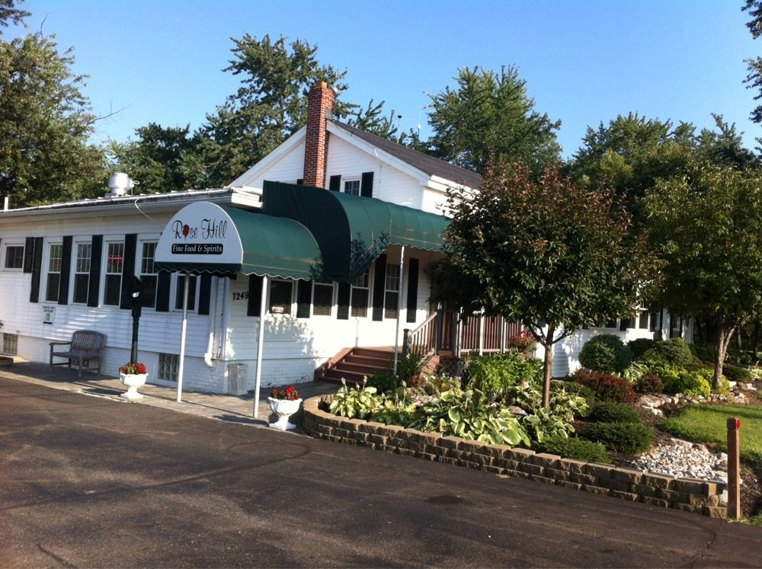
Rose Hill Restaurant April 24, 2015
CCC/EAPA
Regional Meeting – Medina County

Slide 2
MEDINA COUNTY
Medina County, established in 1812, is located in north central Ohio and is the seventeenth most populous county in the state, based on 2000 census figures. Medina County is currently one of the top ten fastest growing counties in Ohio. Medina County comprises approximately 425 square miles.
The City of Medina, the county seat, had a population in 2000 of 25,139. The largest city in terms of population is Brunswick (33,388 - 2000 census). The City of Wadsworth, located in the southeast portion of the county, had 18,437 residents in 2000. In addition to the three cities, there are six villages and 17 townships located within Medina County.
2000 CENSUS DATA is available on the State of Ohio web site.
For detailed STATISTICS on Medina County's POPULATION, ECONOMY, and AGRICULTURE, visit the Medina County Profile Index maintained by the Ohio State University Extension.
Visit the Medina County Economic Development Corp. site for information on BUSINESS and INDUSTRY in Medina County.

Slide 3
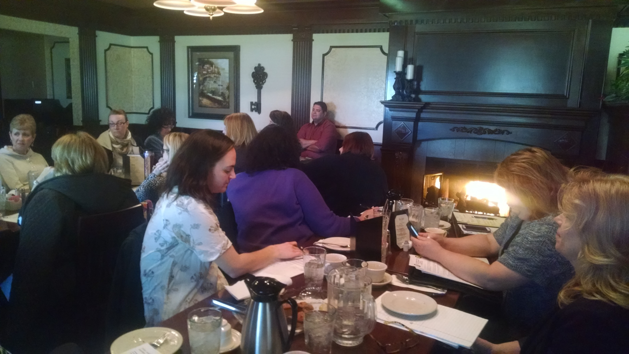
Kelly Hickey
Brian Mead
Gail Crossen
Nikki Hiller
Becky Schaly
Tina Molnar
Heidi Swindell
Paulette Goofrey
Mary Newlove
Nicole Klingeman
Tracy Konik
Lisa Hawkins
Gina Frimel

Slide 4
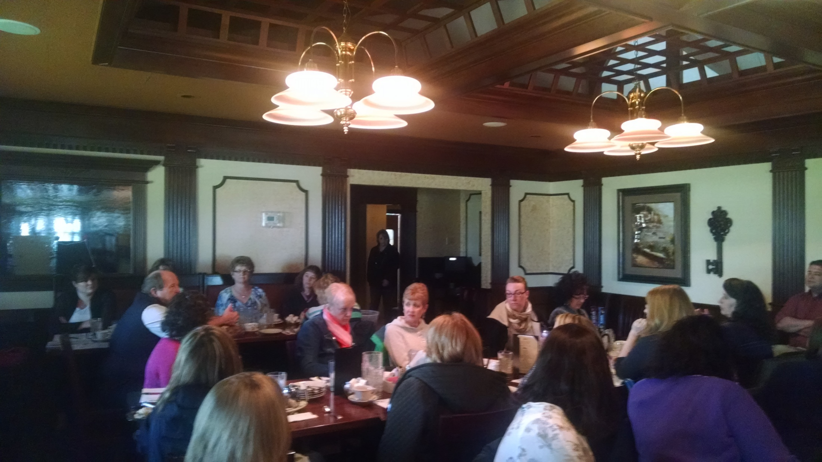
Lee Wortkoetter
Rachel Wood
Brian Mead
Barb Leuthold
Amy Elszasz
Nikki Hiller
John Leutz
Gail Crossen
Kelly Hickey
Amy Ehasz
Peggy Folk
Tina Molnar
Becky Schaly
Barbara Powell
Mary Newlove
Nicole Klingeman
Pam Jones
Tracy Konik

Slide 5
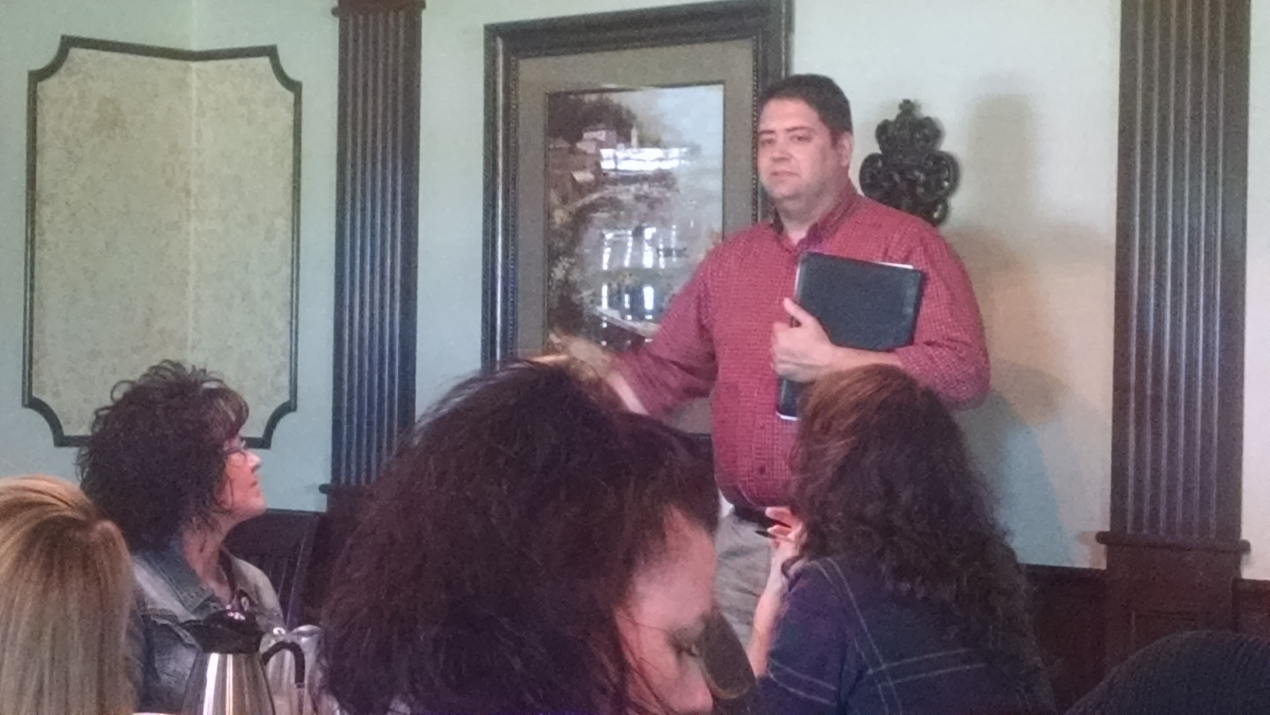
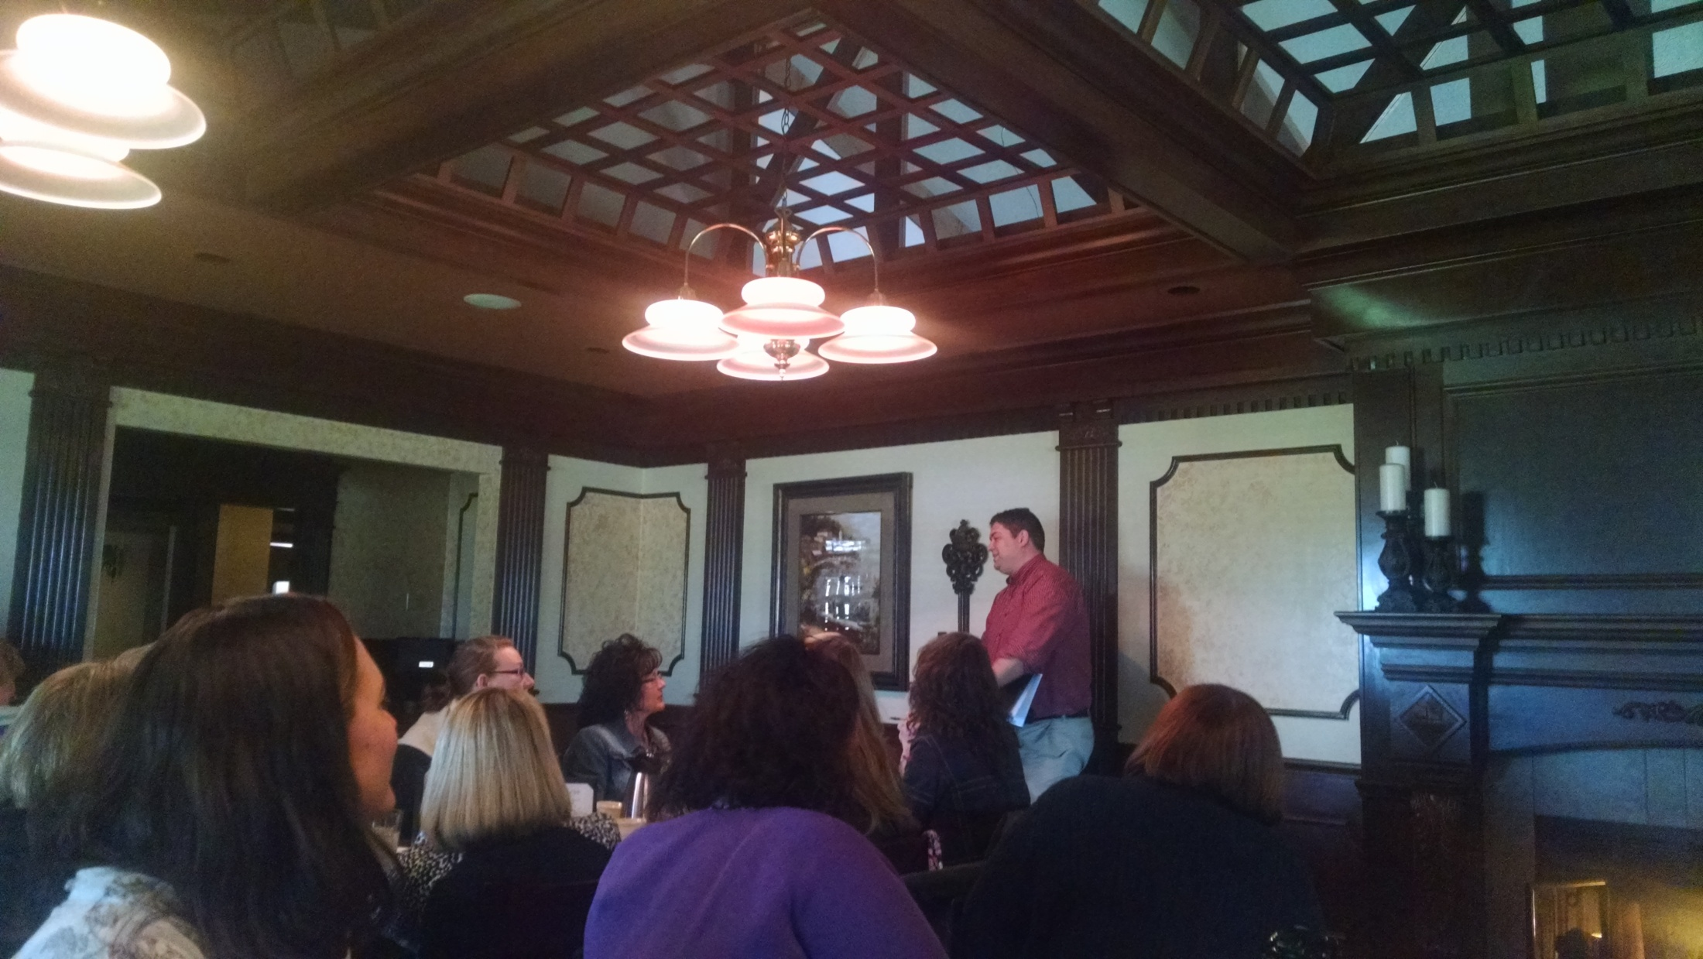
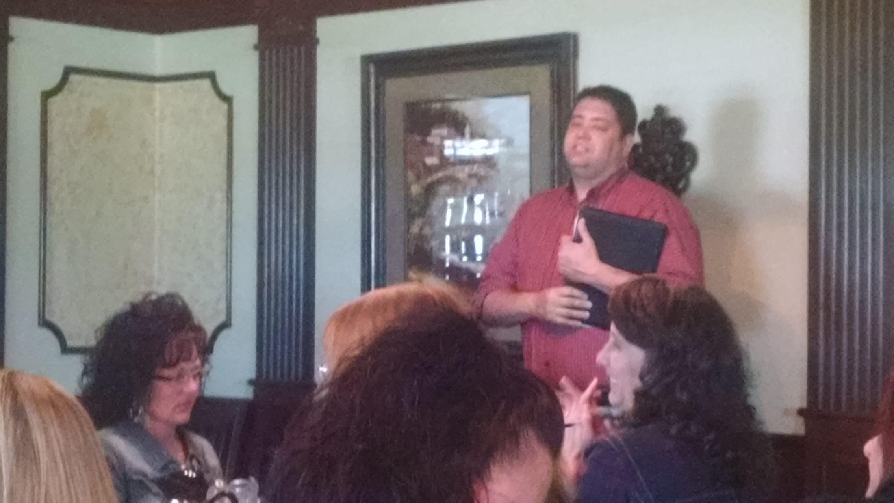
Brian Mead – CCAO
legislative update

Slide 6
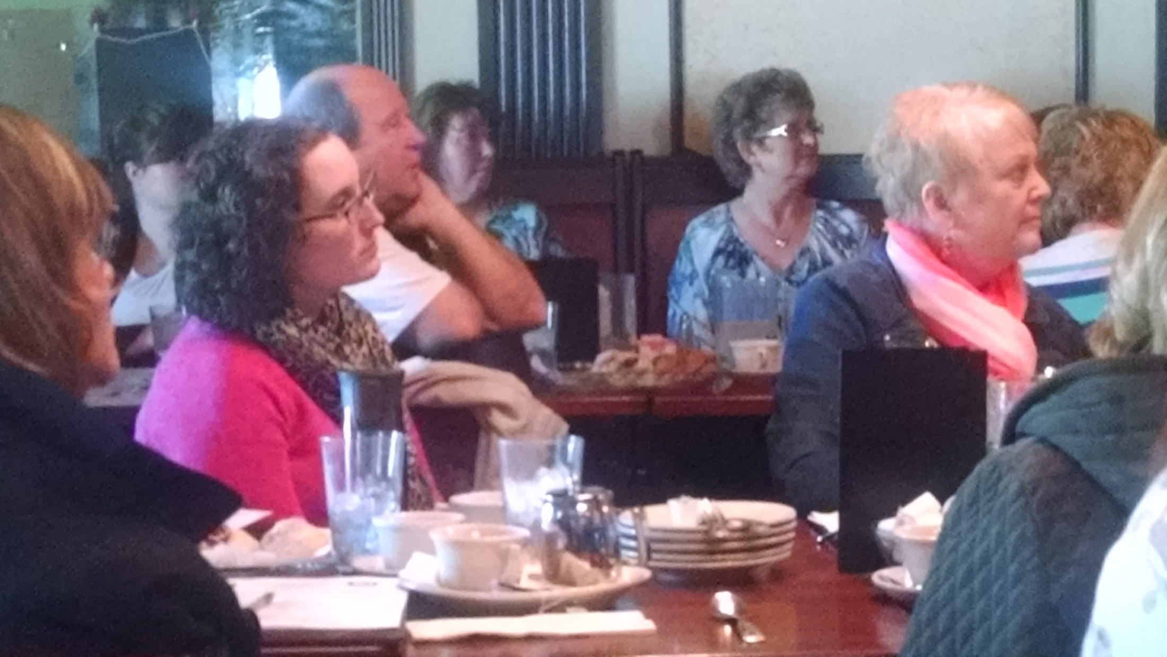
April Gonzalez
Barb Leuthold
John Leutz
Peggy Folk
Amy Ehasz

Slide 7
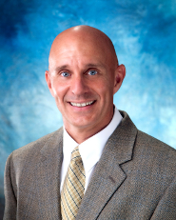
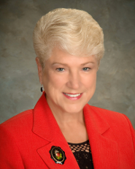
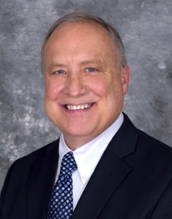
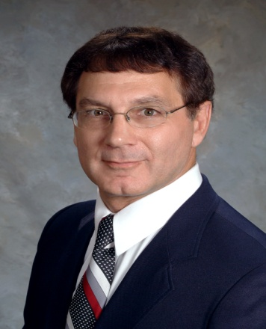
Medina County Commissioners
Adam Friedrick
Patricia G. Geissman
Timothy C. Smith
Medina County Engineer
MIKE SALAY, P.E., P.S.

Slide 8
23 in attendance
representing 10 counties;
Ashland, Ashtabula, Crawford, Coshocton, Geauga, Huron, Lake, Licking, Lorain, Medina, Ottawa, Summit, Trumbull & Williams
12 from engineers
11 from commissioners office

Slide 9
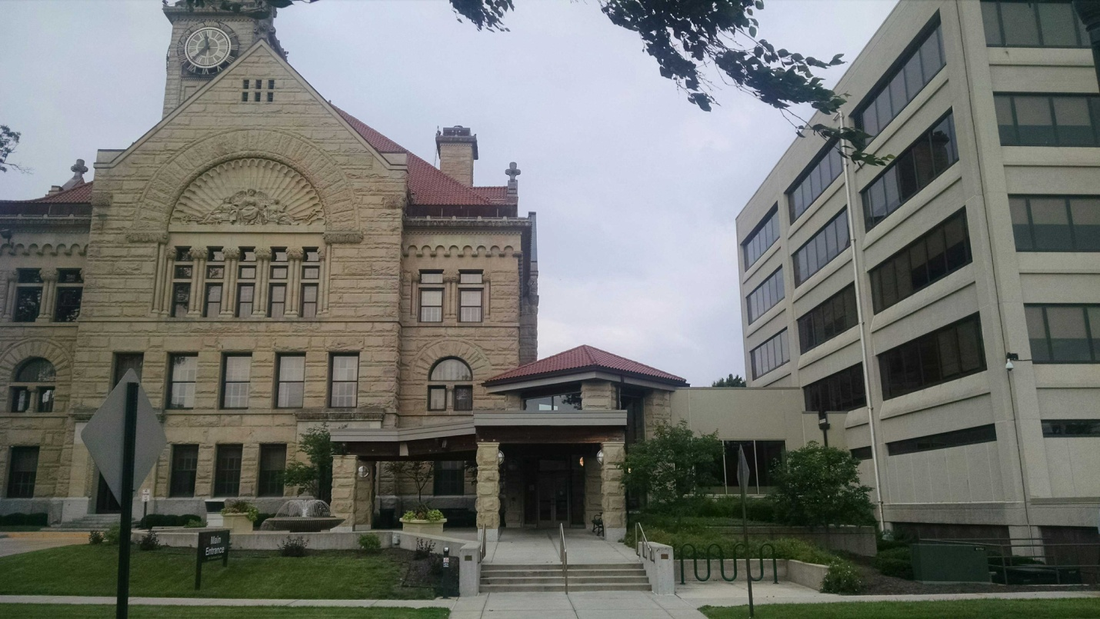
Administration Building / Courthouse June 12, 2015
CCC/EAPA
Regional Meeting – Wood County

Slide 10
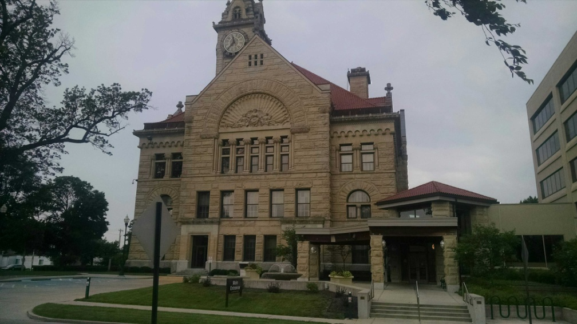
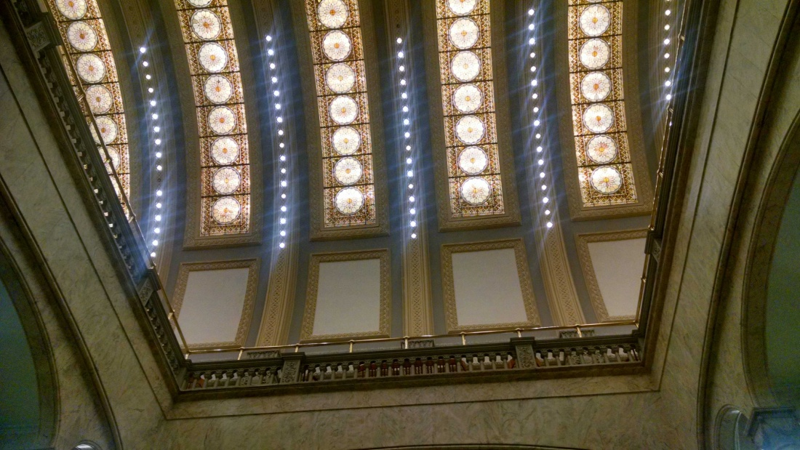
Wood County was organized on February 12, 1820, when the legislature carved 14 counties from the lands purchased from the Wyandot, Seneca, Delaware, Shawnee, Potawatomi, Ottawa, and Chippewa tribes as a result of the Lower Maumee Treaty of September 28, 1817. In May 1822, the Commissioners designated Perrysburg as the first County Seat. It remained so until 1868 when the Seat of Justice was moved to Bowling Green
Lucas County was then a part of Wood County and Maumee was named by law as the temporary Seat of Justice. The Act further provided that the unorganized counties of Hancock, Henry, Putnam, Paulding, and Williams should be attached to Wood County for civil purposes until further provisions were made by law.
The County lines were the same as now, except that the northern boundary extended to Michigan. In 1835, Wood County was dismembered when Lucas County was formed and the Maumee River became its northern boundary.
Wood County was named for Colonel Eleazor D. Wood, a graduate of West Point, a gallant soldier, and the engineer who planned Fort Meigs.
Out of the Great Black Swamp of yesterday emerged a well drained, rich, fertile, and productive county.
Wood County has nineteen townships, twenty-one villages and five cities.
Visit the Wood County Historical Center and Museum to learn more information about Wood County and Northwest Ohio.
The courthouse was placed on the National Register of Historic Places in 1973
stained glass on the ceiling over the marble staircase.

Slide 11
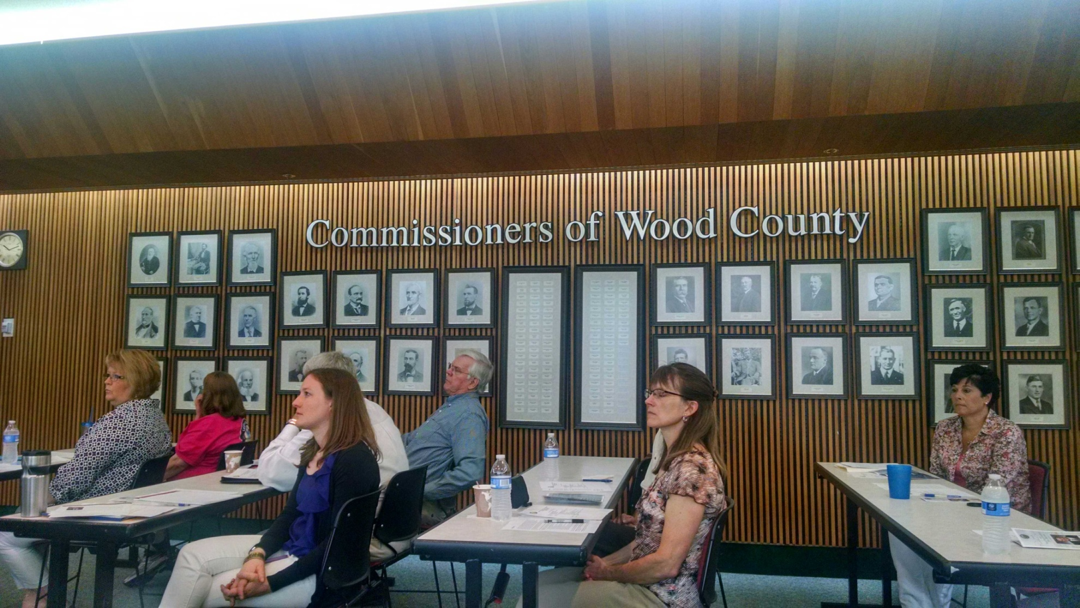
Kim Warnke
Ray Huber
Nancy Dennis
Dee Stewart
Karen Heinrichs
Jesicca Sautter

Slide 12
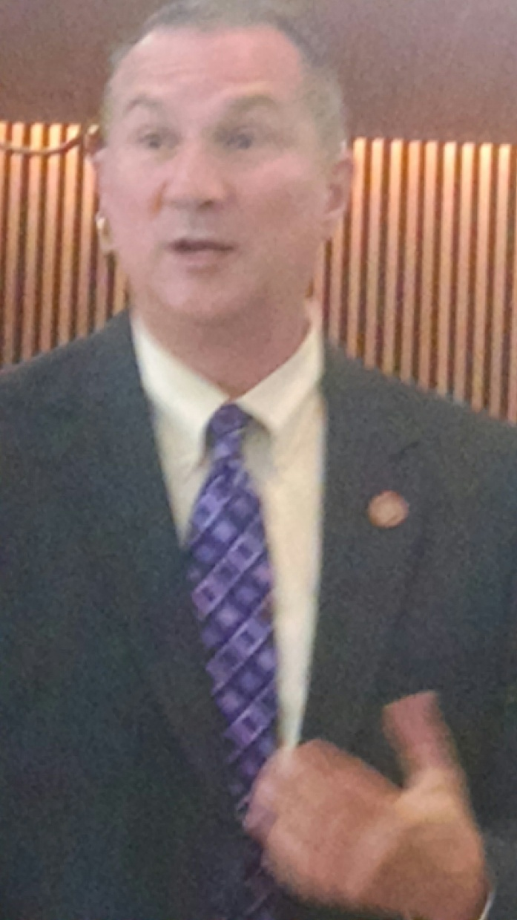
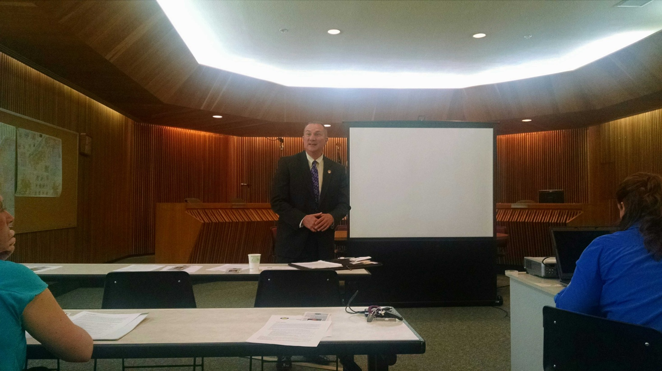
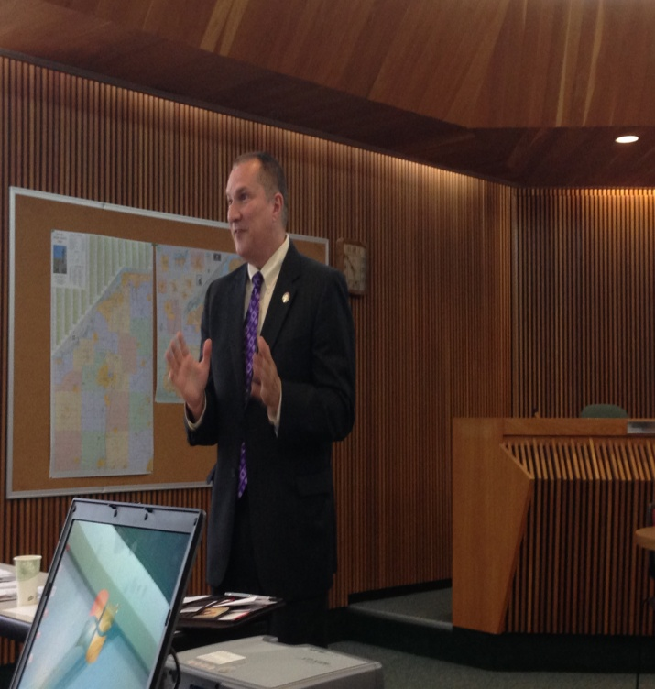
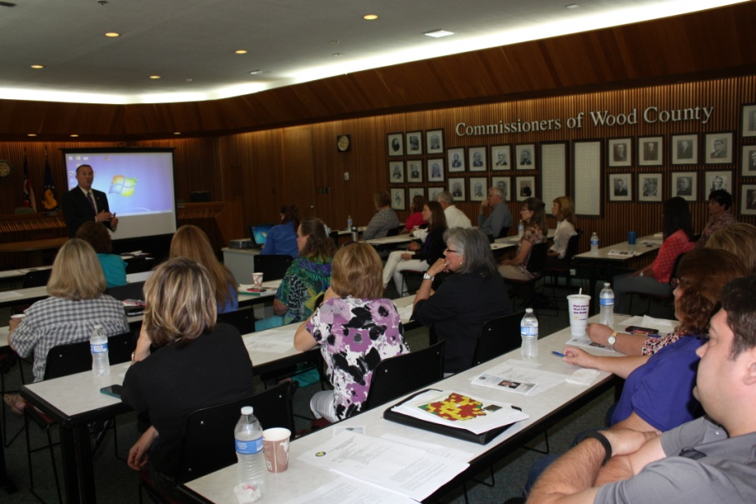
State Representative Tim Brown is serving his second term in the Ohio House of Representatives. He represents the 3rd Ohio House District, which includes all of Wood County.
Representative Brown previously served four terms as a Wood County Commissioner and was vice president of the board. He also served as vice president of the County Commissioners Association of Ohio (CCAO) for 2012 and also worked on a number of committees for the CCAO, including the General Government Committee, the Joint Committee on Administration of Elections, and the Commissioners and Sheriffs Task Force Committee. He is also the past president of the Northwest Ohio Commissioners and Engineers Association.
Prior to his election as a Wood County commissioner, Representative Brown worked as district representative for the late U.S. Congressman Paul Gillmor, where he managed the congressman’s Wood County office and provided constituent service dealing with many government agencies. He also served as the business manager for the Sanitary Engineering Office.
Representative Brown is a graduate of Bowling Green State University’s College of Business. He is very active within the community and serves on numerous committees and task forces.
Tim Brown
State Rep

Slide 13
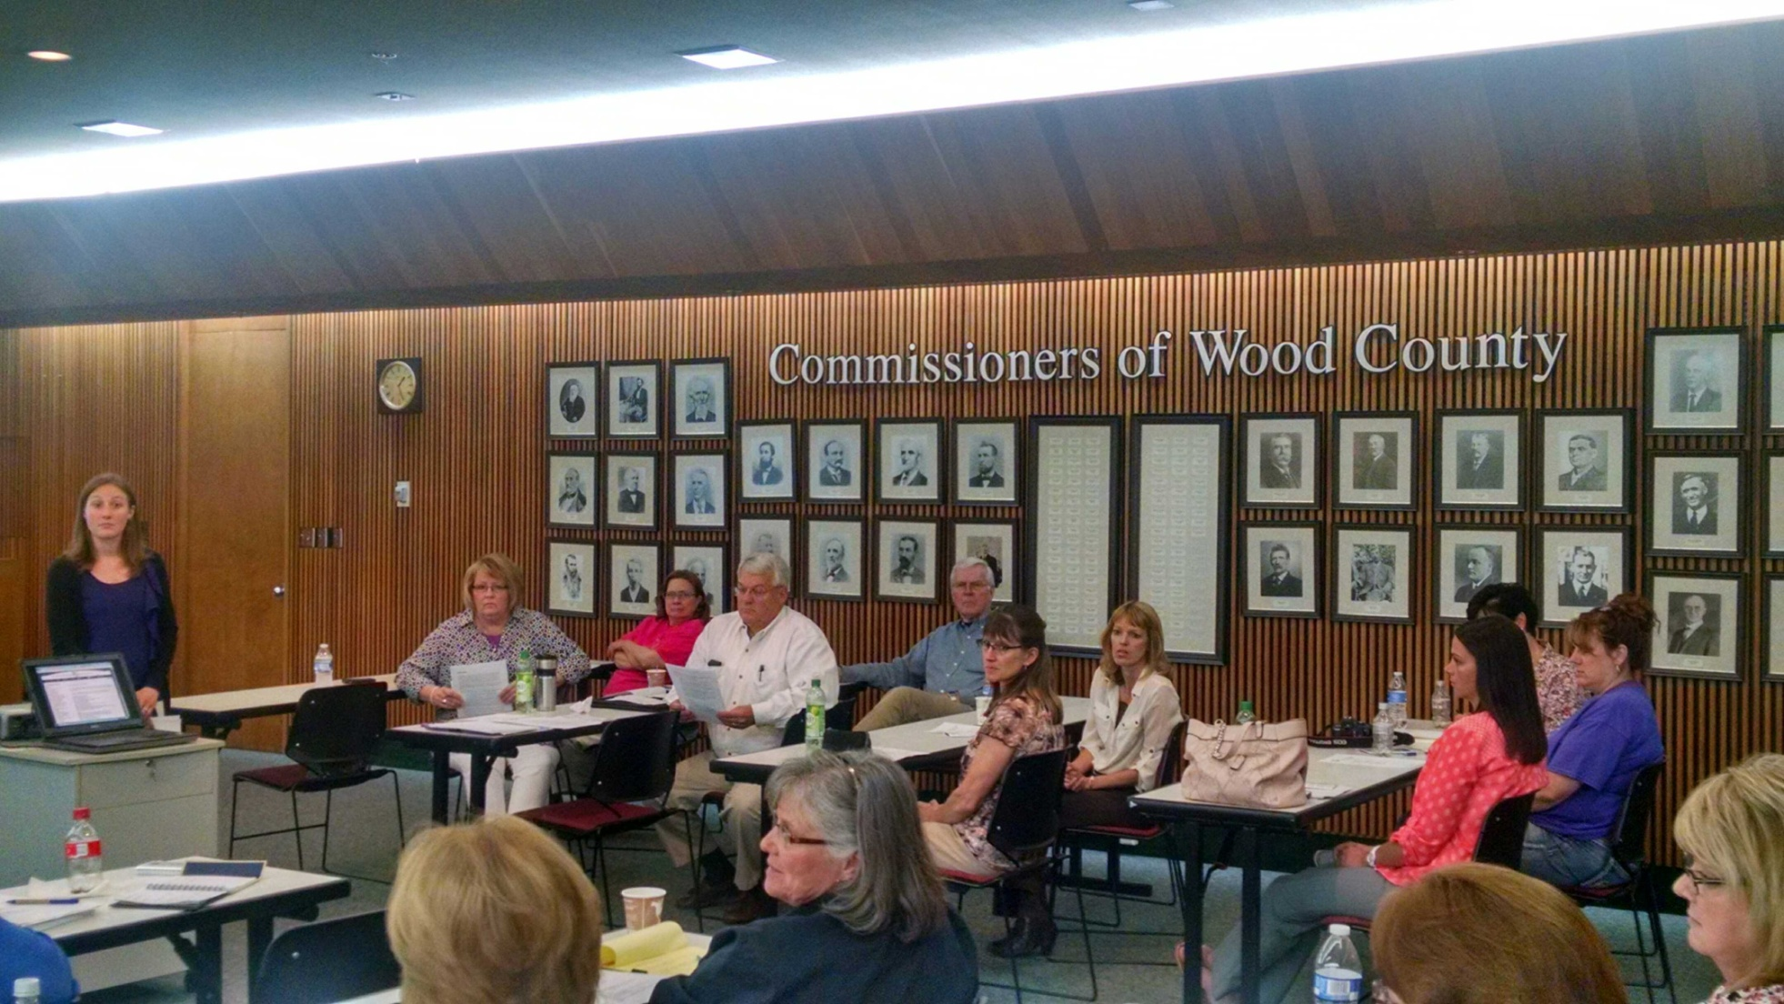
Kim Warnke
Jesicca Sautter
Ray Huber
Nancy Dennis
Kim Everman
John Musteric
Sandy Long
Karen Hendrichs
Lindsey Neifer
Denise Longstreth
Diana Groves

Slide 14
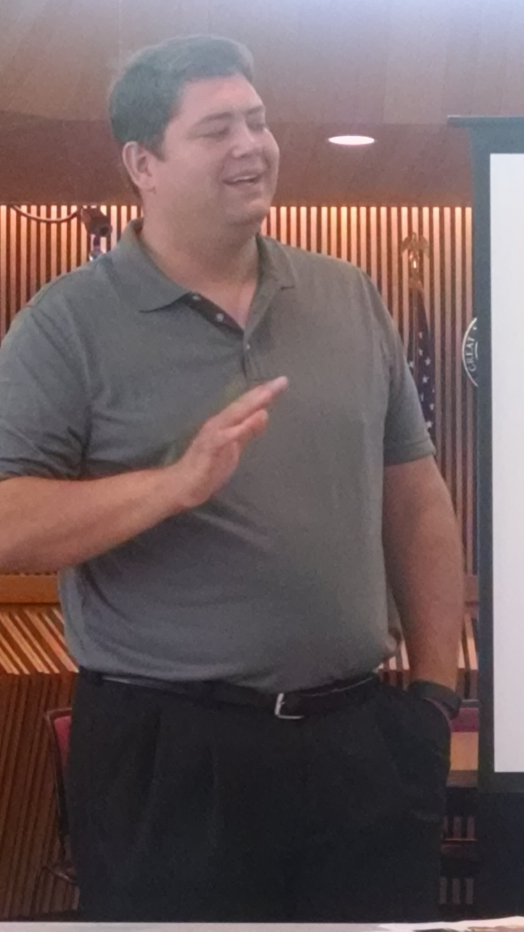
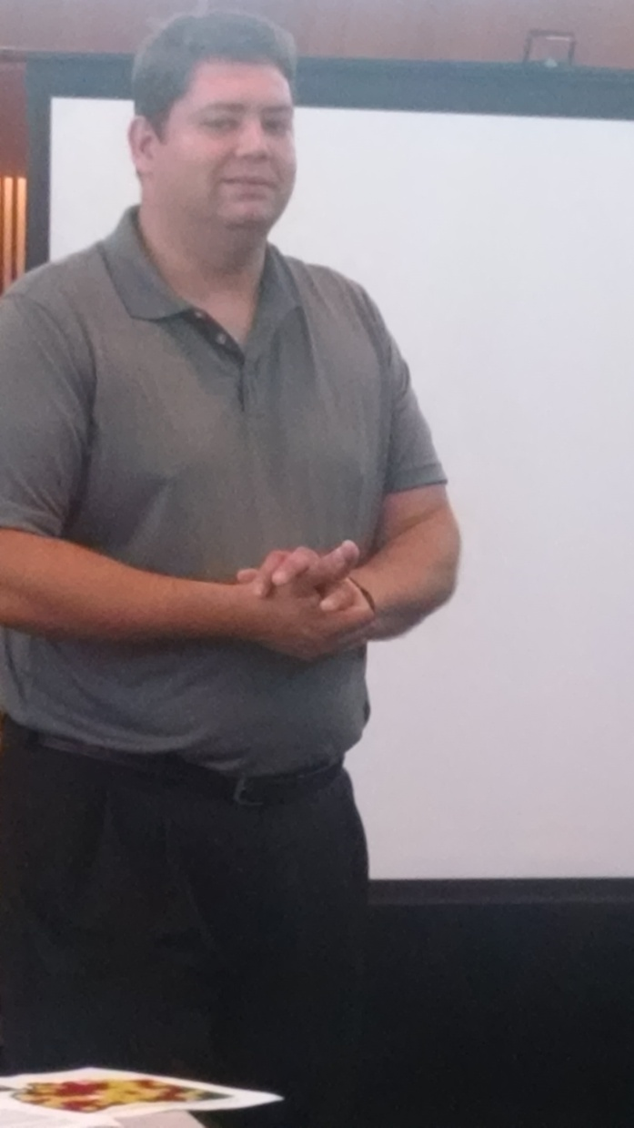
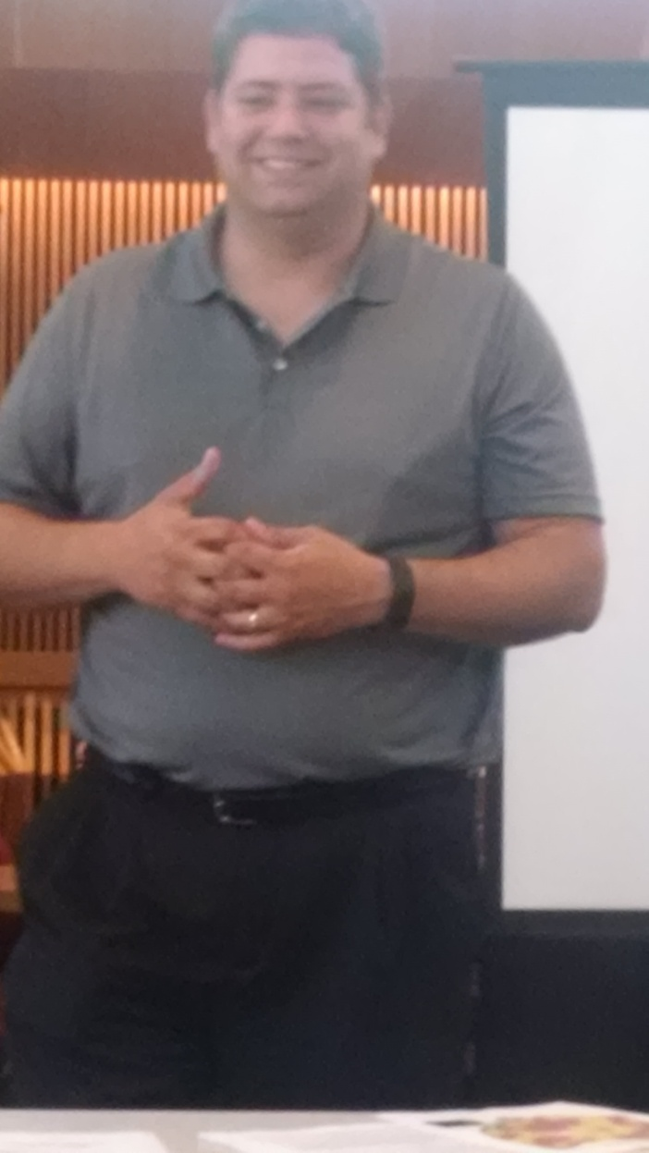
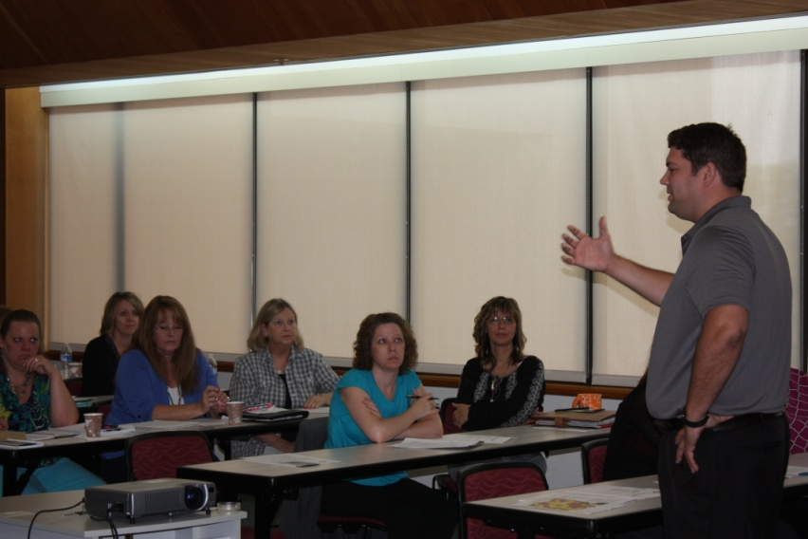
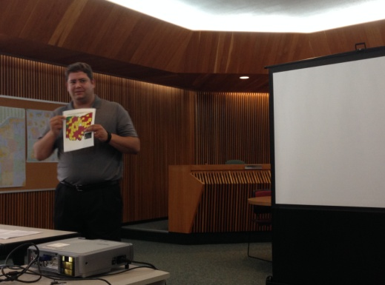
Many Faces of
Brian Mead - CCAO
Legislative Updates

Slide 15
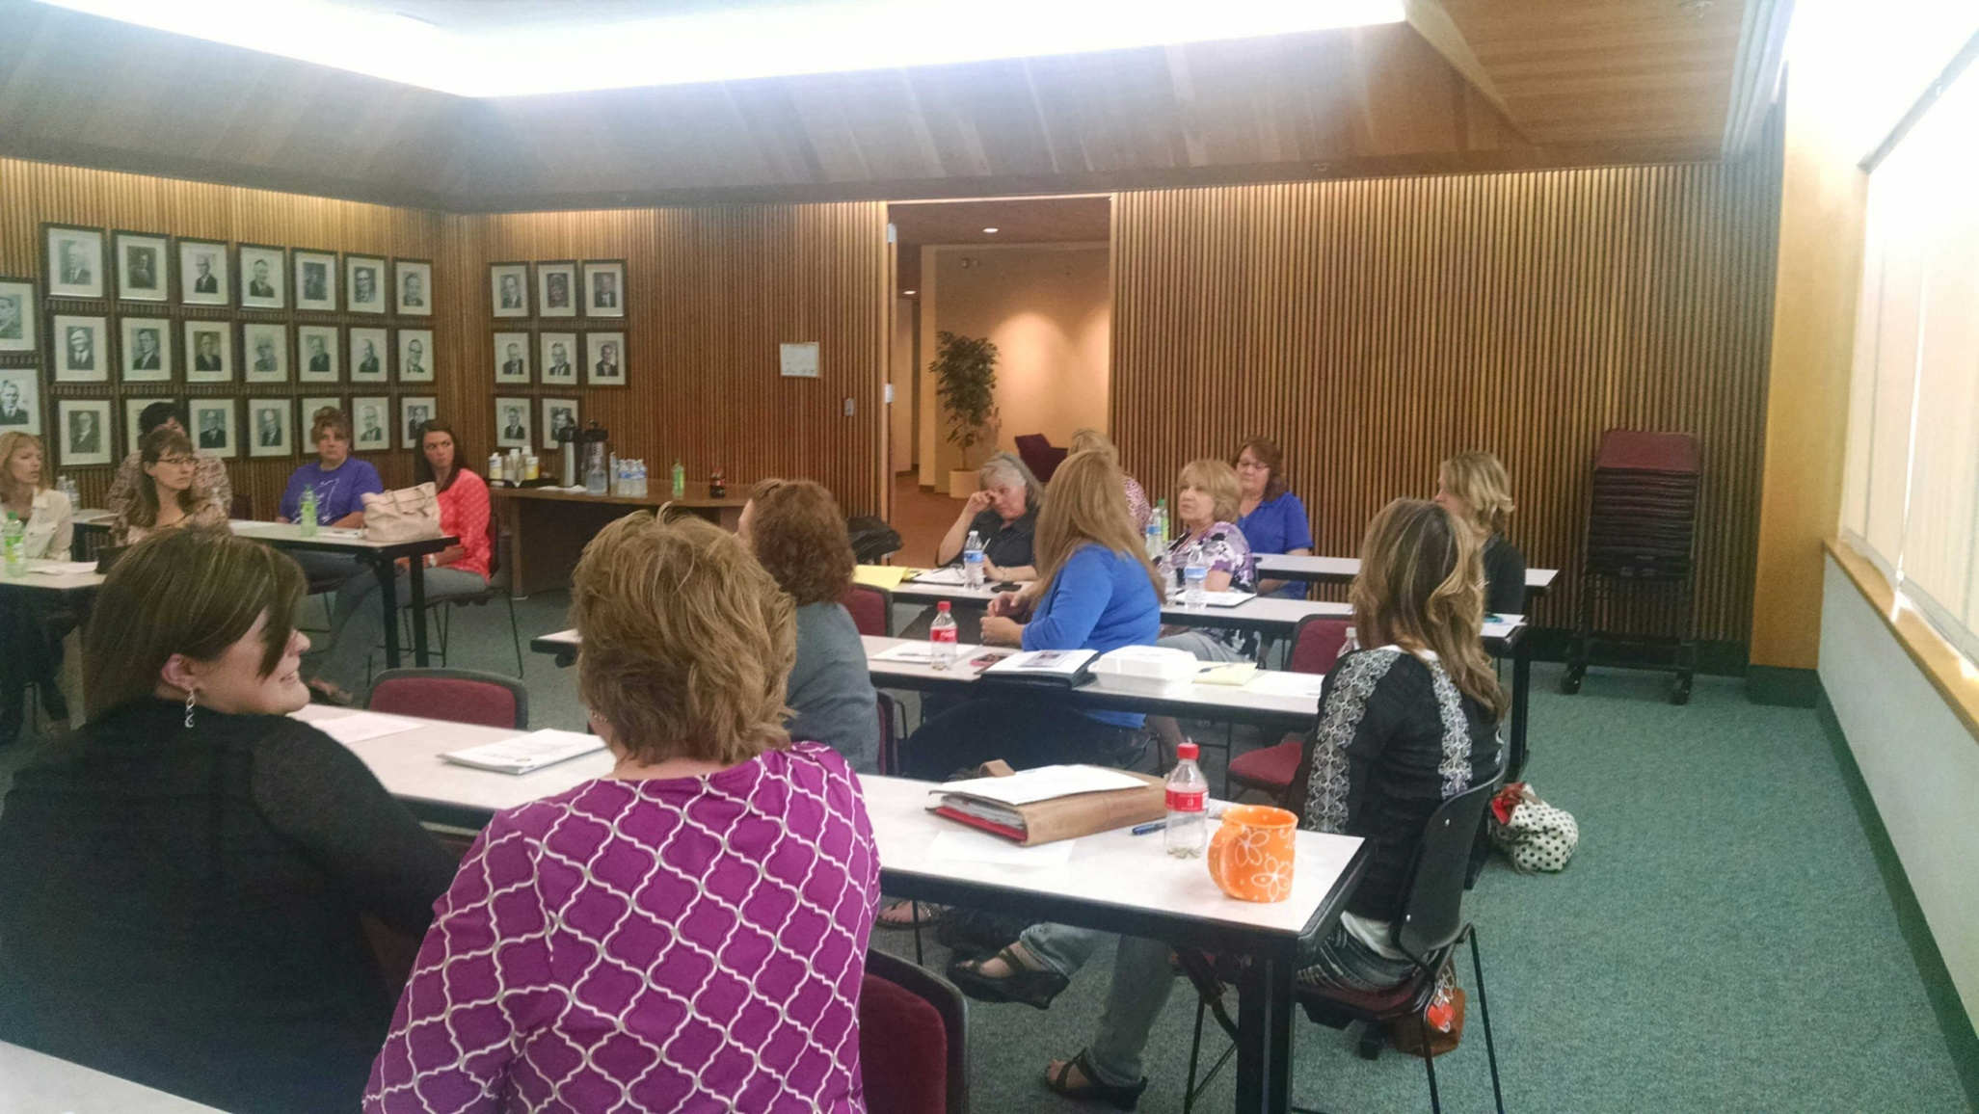
Sandy Long
Karen Hendricks
Lindsey Neifer
Denise Longstreth
Lisa Hipke
Kim Everman
Mary Newlove
Lisa Sugg
Janice Leggett
Tina Molnar
Pam Boyer
Lee Wortkoetter
April Gonzalez

Slide 16
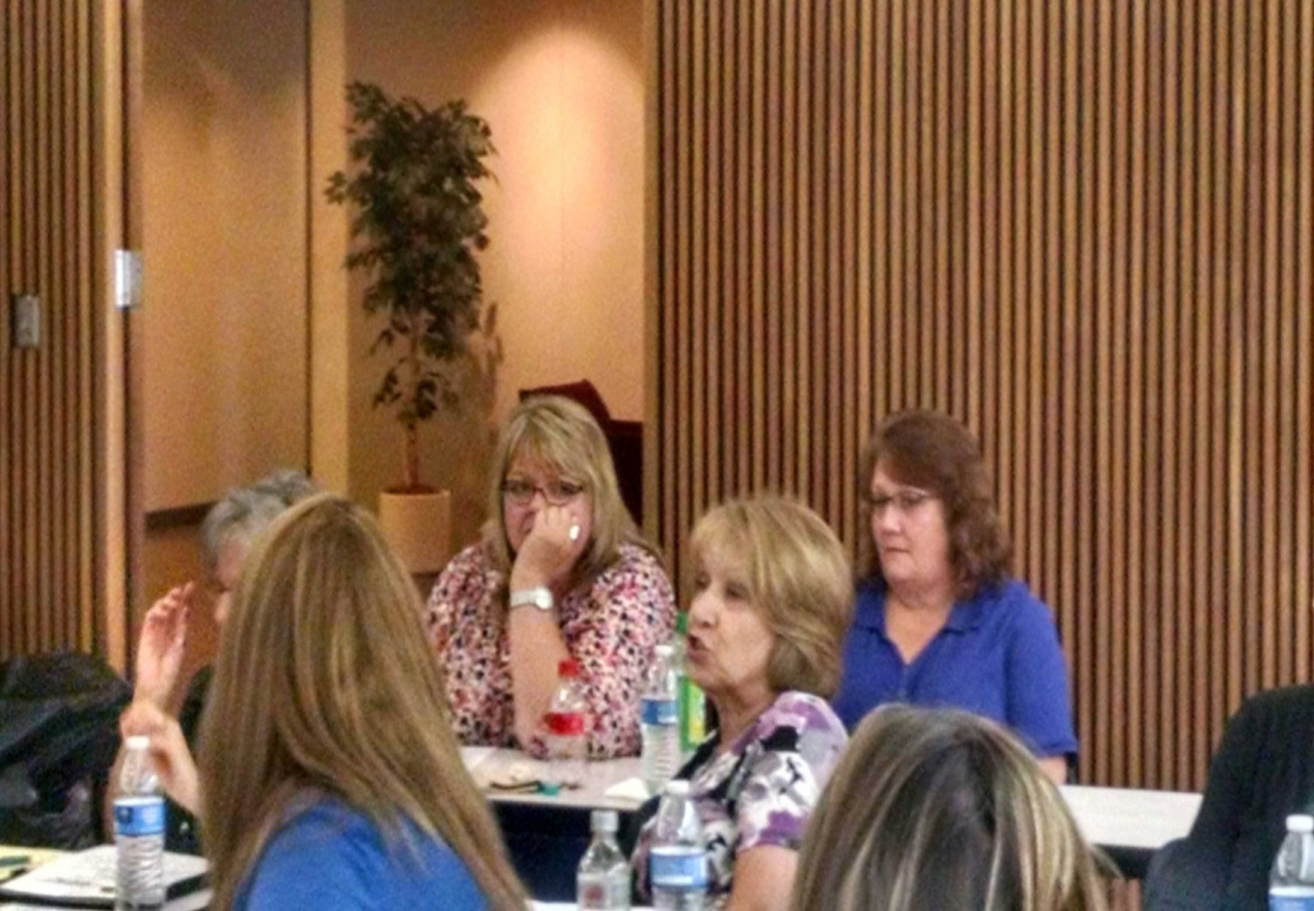
Diana Groves
Lisa Hipke
Marie Newlove
Tina Molnar
Carolyn Hauenstein

Slide 17
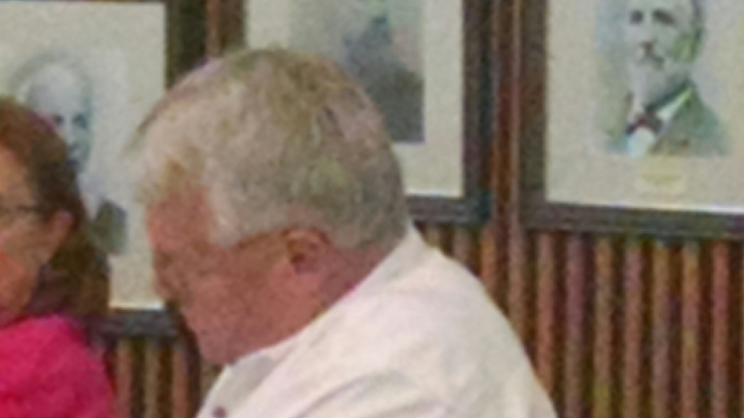
John Musteric

Slide 18
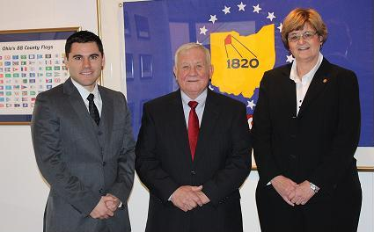
Wood County Commissioners
Joel M. Kuhlman
James F. Carter
Doris I. Herringshaw

Slide 19
22 in attendance
representing 11 counties;
Carroll, Clinton, Erie, Fulton, Henry, Lorain, Mercer, Ottawa, Summit, Wood & Williams
11 from engineers
11 from commissioners office

Slide 20
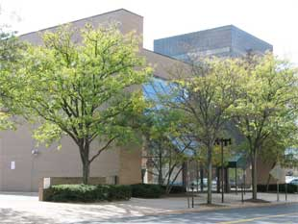
CCAO Offices September 25, 2015
CCC/EAPA
Regional Meeting – Franklin County

Slide 21
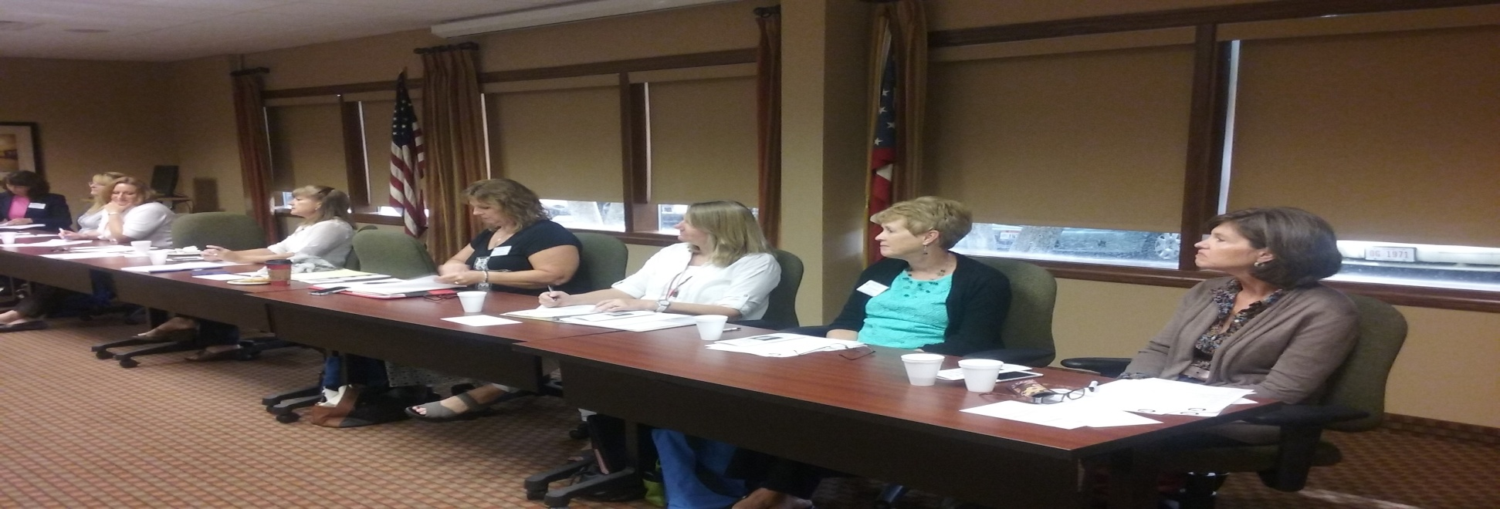
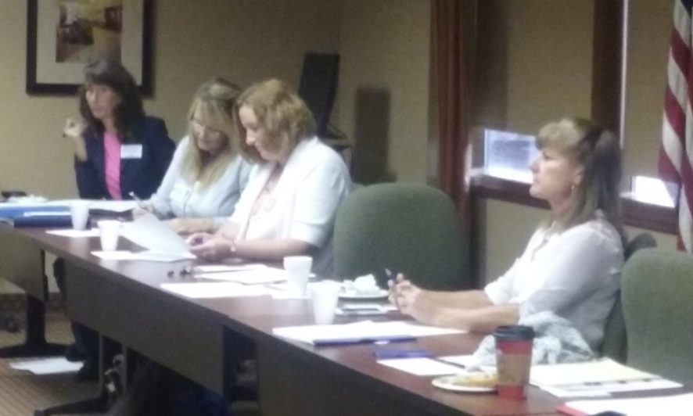
CCC/EAPA 2015 EXECUTIVE BOARD MEMBERS
Tina
Molnar
Stacy
Crall
Becky
Schaly
Ronda Conrad
Lisa Shaffer
Gail Crossen
Linda Reigle
Pam Jones
Becky Schaly
Tina
Molnar
Board meetings are held 4-5 times per year to plan the regional networking and conferences
Stacy Crall
Ronda Conrad

Slide 22
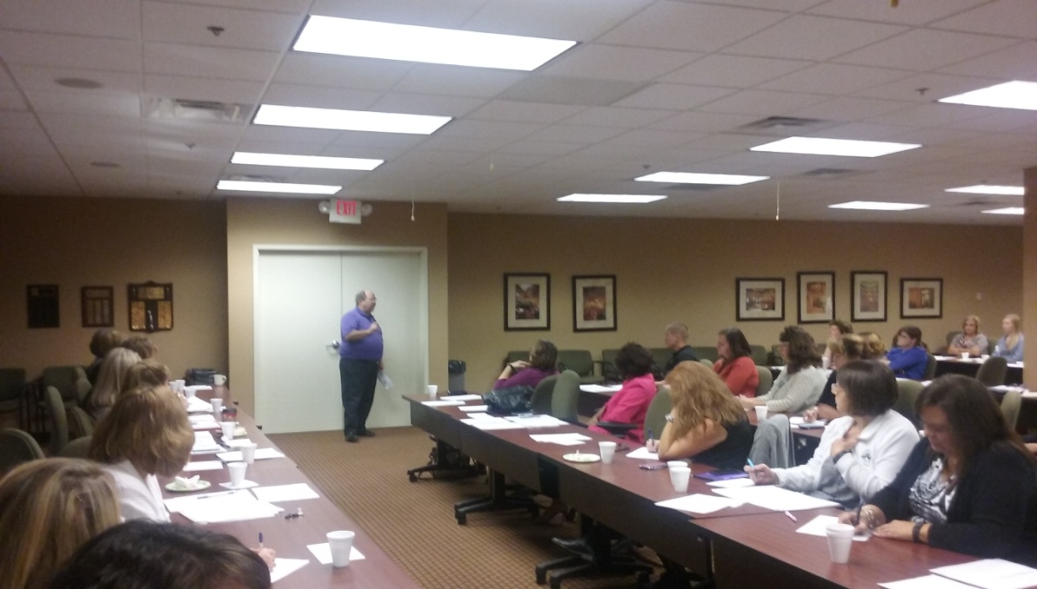
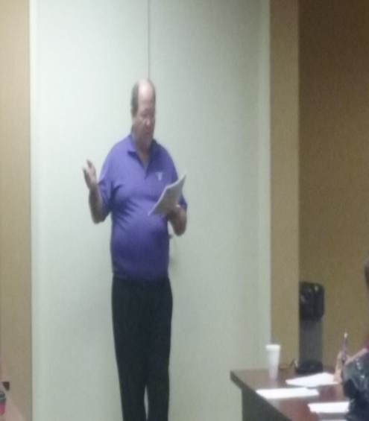
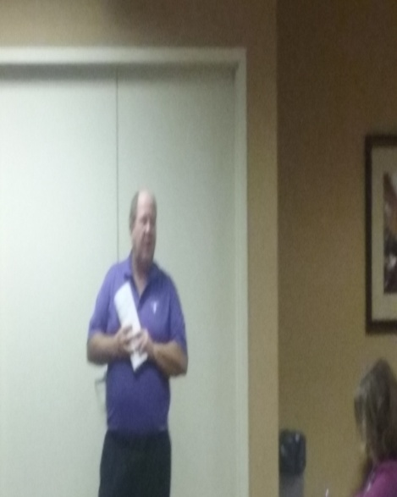
John Leutz, CCAO
Legislative Updates

Slide 23
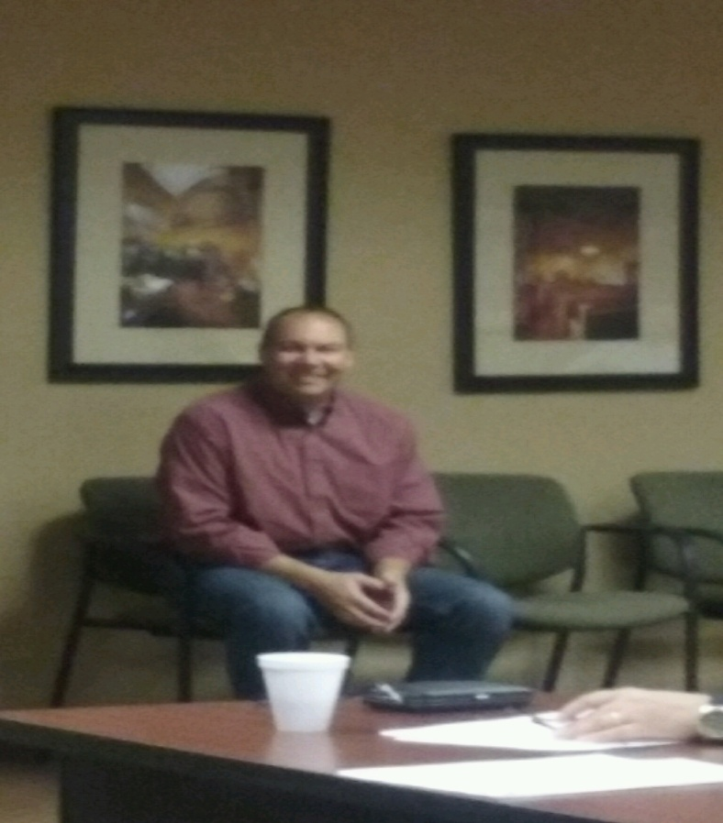
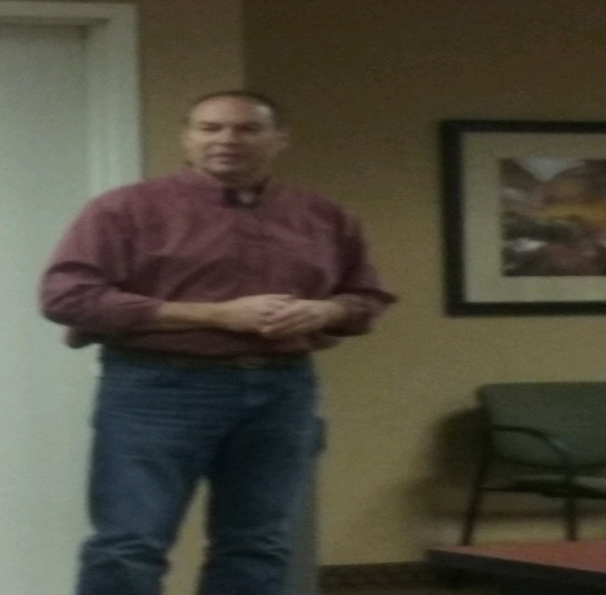
Senator Bob Peterson
Bob is a life-long farmer from Fayette County.
He graduated cum laude from the Ohio State University with a Bachelor’s of Science Degree in Agriculture.
Between 1987-1989, Peterson was a part of the OSU Leadership Development Class (LEAD), which included educational experiences in Japan, China, and Korea. The class provided Peterson with extensive experiences in leadership, media training, state and national political processes, economics, environmental issues, food safety and security, social issues and family values.
He and his wife, Lisa, are the parents of three children: Sarah, Hannah, and Todd.
Peterson’s resume is impressive. He has contributed at the local, state and national level as a volunteer, elected leader, government official and advisor.
He was a Fayette County Commissioner for 14 years before being elected as District 17 Senator serving he counties of; Fayette, Gallia, Highland, Jackson, Lawrence (part), Pickaway (part), Pike, Ross, Vinton (part)
He explained how a bill becomes a law

Slide 24
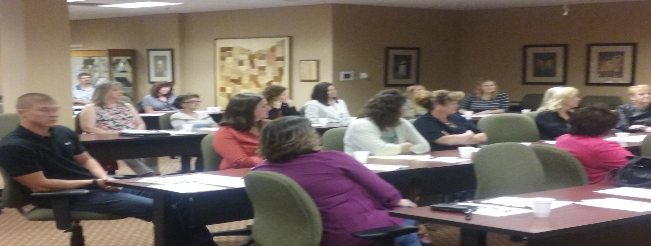
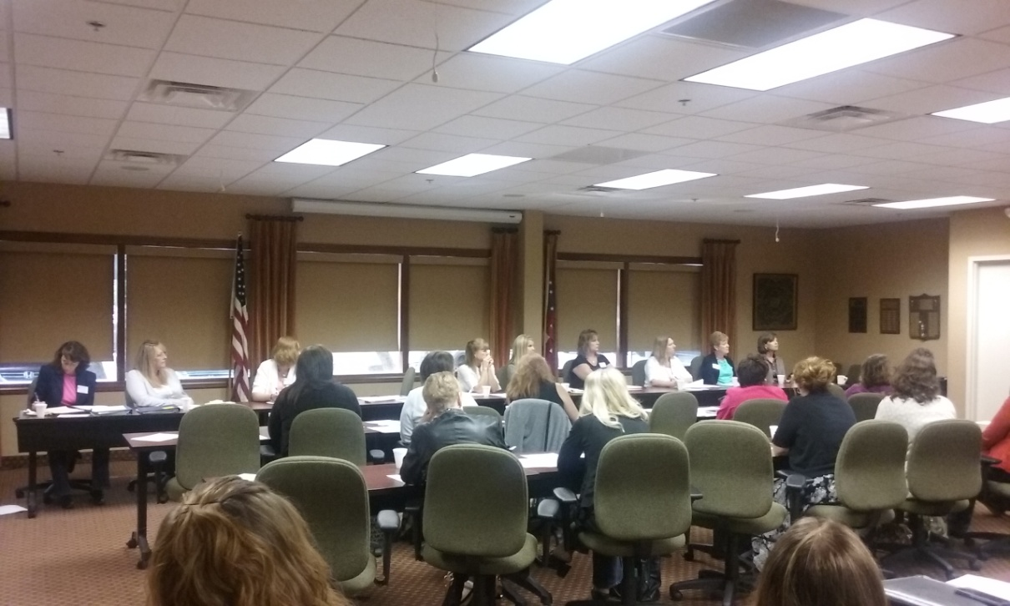
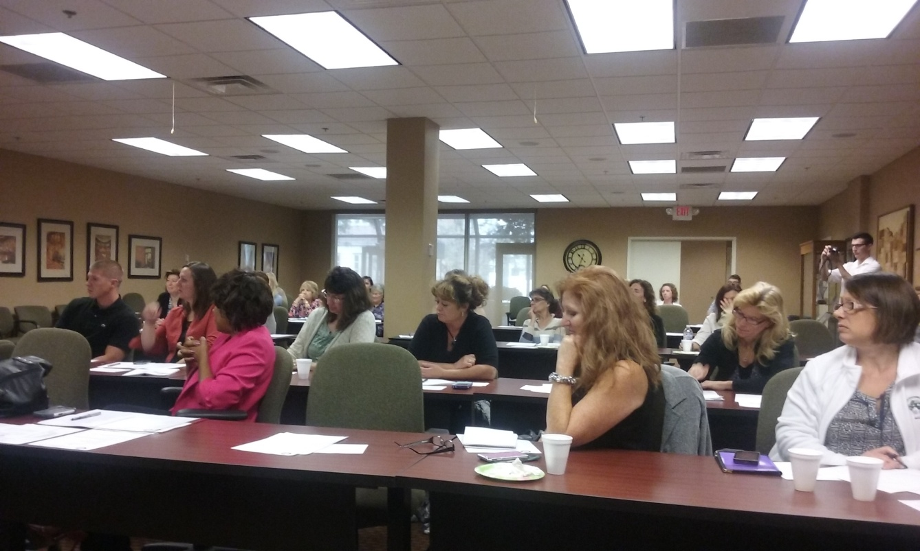
Nick Adams
Bev Adzic
Nicole Oberrecht
Gina Frimel
Nick Adams
Cheryl Heacock
April Brown
Flora Butler
Jane Clay
Crystal Digenova

Slide 25
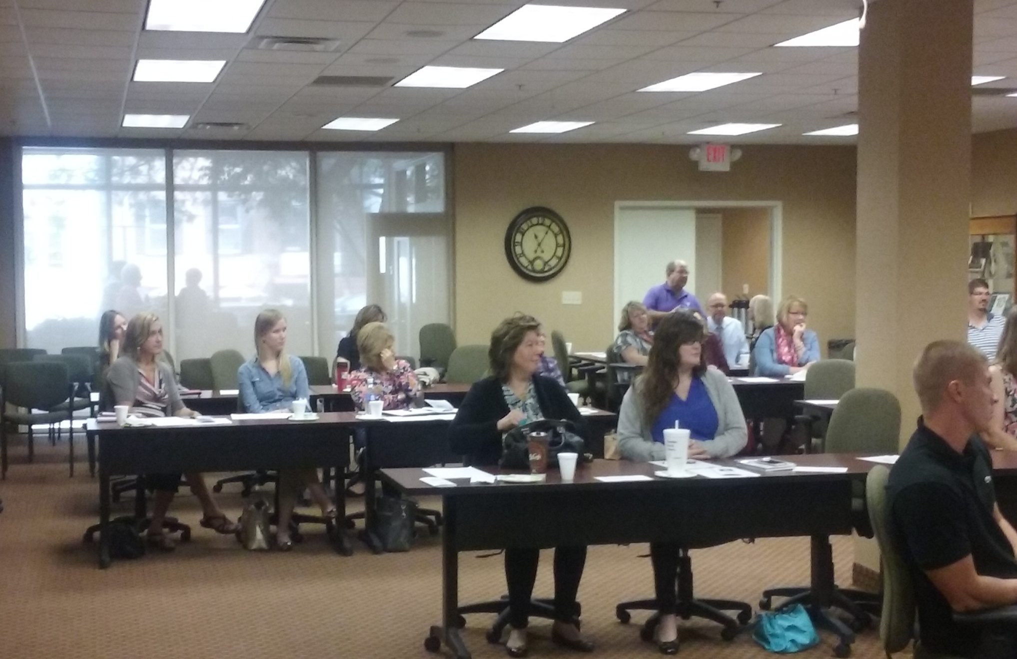
John Leutz
Chris Medranski
Brad Cole
Lisa Hawkins
Jennifer Shuey
Maria Newlove
Allison Sweeney
April Gonzalez
Lee Wortkoeller
Nick Adams

Slide 26
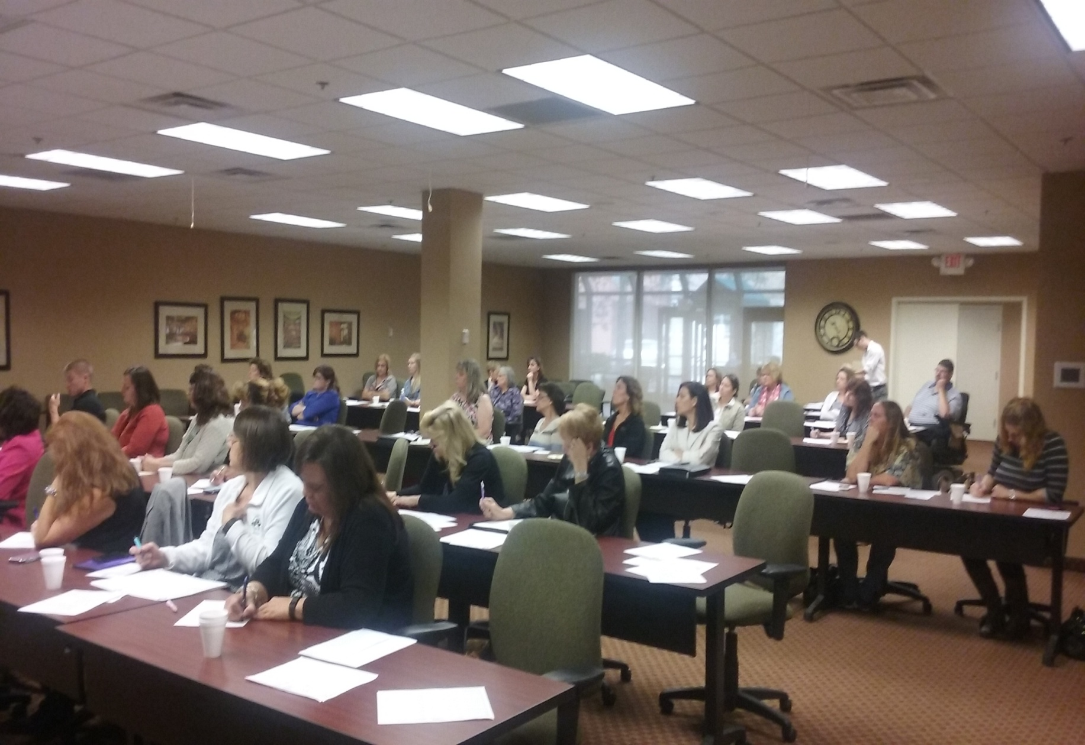
Vicki Ziemba
Andrew Johnson
Denise Longstreth
Sara Morrisey
Janice Legett
Gail Stout
Chris Medranski
Patricia Webb
Belinda Fulton
Cheryl Edwards
Gina Frimel
Commissioner Marilyn John
Emily Hetzman
Peggy Folk
Megan Lokai
Maria Lautenschleger

Slide 27
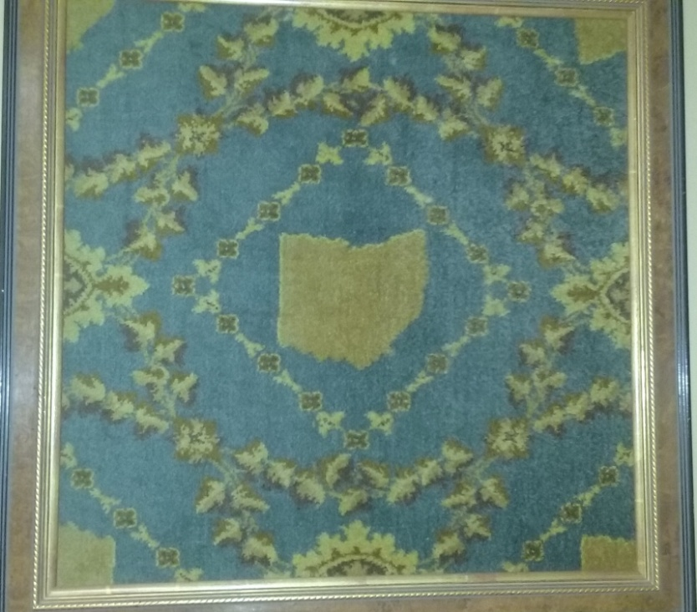
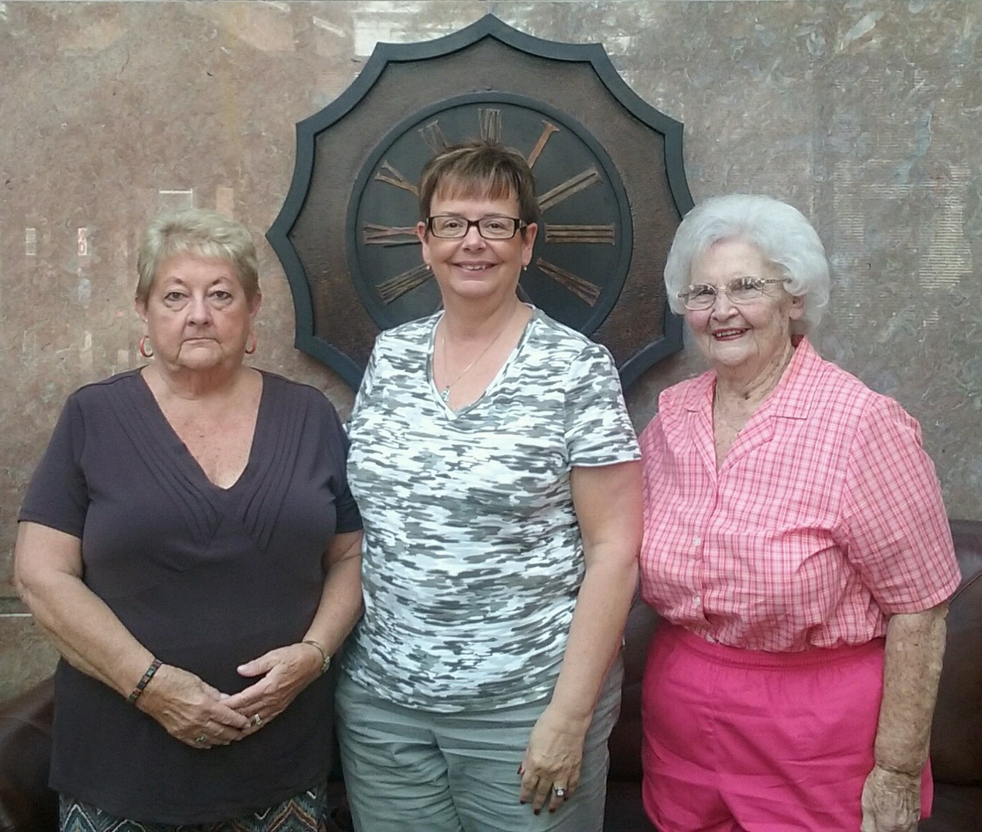
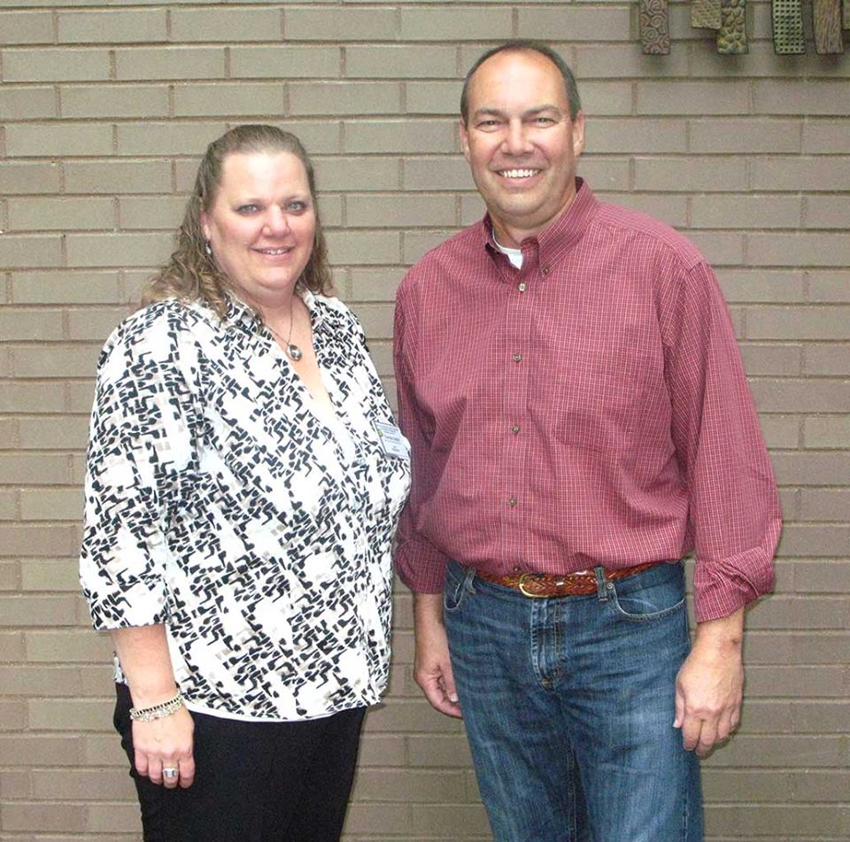
Retirees
State Map
Betty Huffman
Sally Clemans
Senator
Bob Peterson
Nancy Kramer
Theresa Upton

Slide 28
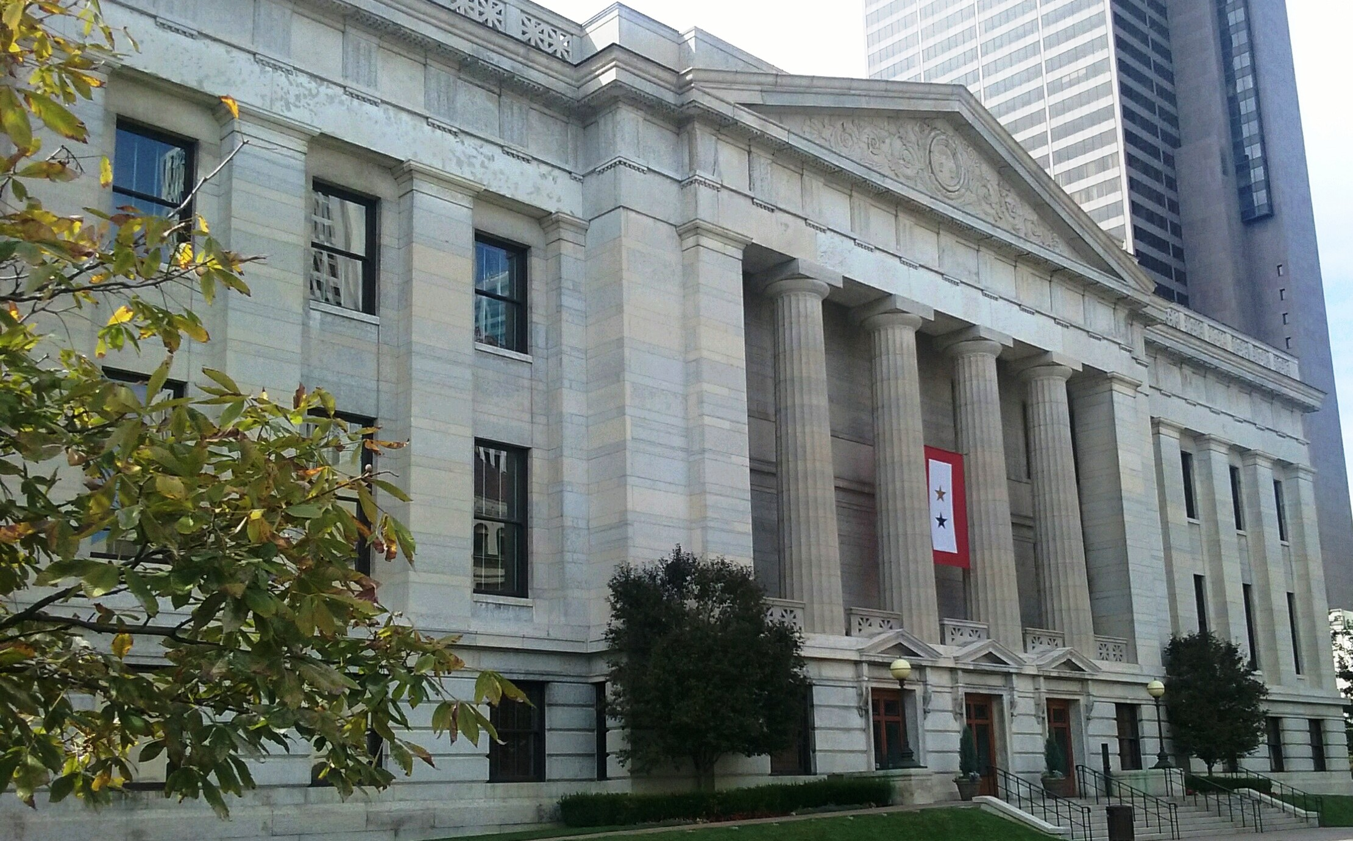
TAKING A TOUR OF THE STATEHOUSE

Slide 29
The Statehouse is situated on a 10-acre parcel of land that was donated. Construction actively began on July 4, 1839 with the ceremonial laying of the cornerstone. The structure would be completed much later, in 1861.
The Statehouse is built in the Greek Revival style. It is a masonry building, consisting largely of Columbus limestone.
The limestone was taken from a quarry on the west banks of the Scioto River. The stone of the Statehouse foundation is more than 18 feet deep. The completed basement and foundations were actually filled in with soil and Capitol Square was used as a pasture.
One of the most notable Statehouse architects was Ohio-born Nathan B. Kelley. It was Kelley who discovered that the Statehouse had been planned without any heating or ventilation system. He corrected this problem by building brick walls inside the building that he referred to as "air sewers" that would function like ductwork in a modern heating system, moving air throughout the building.
The Statehouse was opened to legislators and the public in 1857. The Statehouse has been designated a National Historic Landmark by the Secretary of the U.S. Department of the Interior.

Slide 30
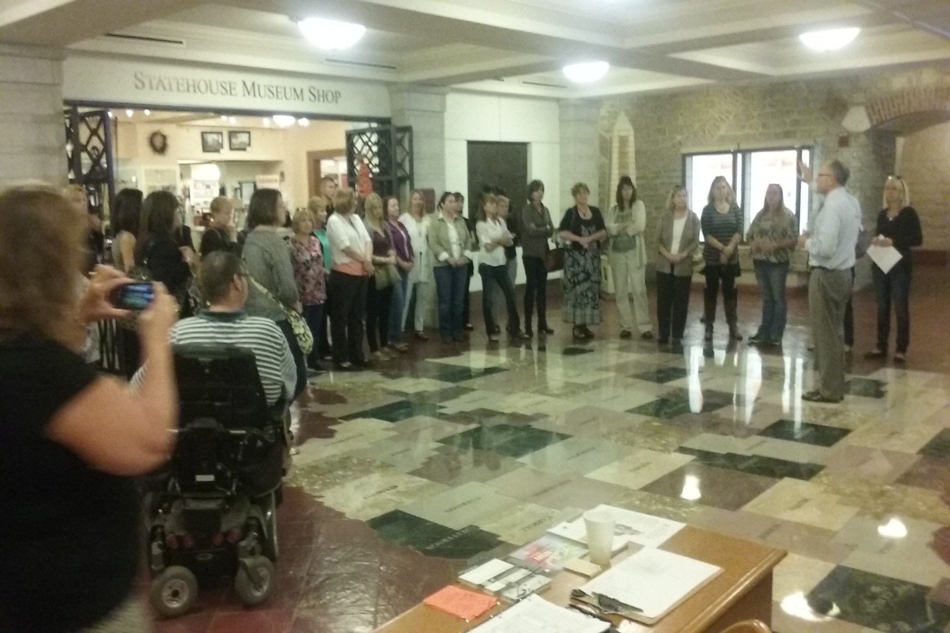
State Map Room. Brad Cole, CCAO said that CCAO donated funds for this map of all counties to be placed into this room. CCC/EAPA members waiting to go on the tour

Slide 31
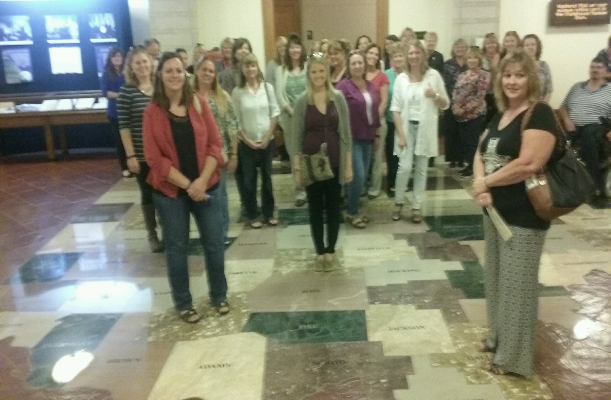
CCC/EAPA members standing on their respective counties

Slide 32
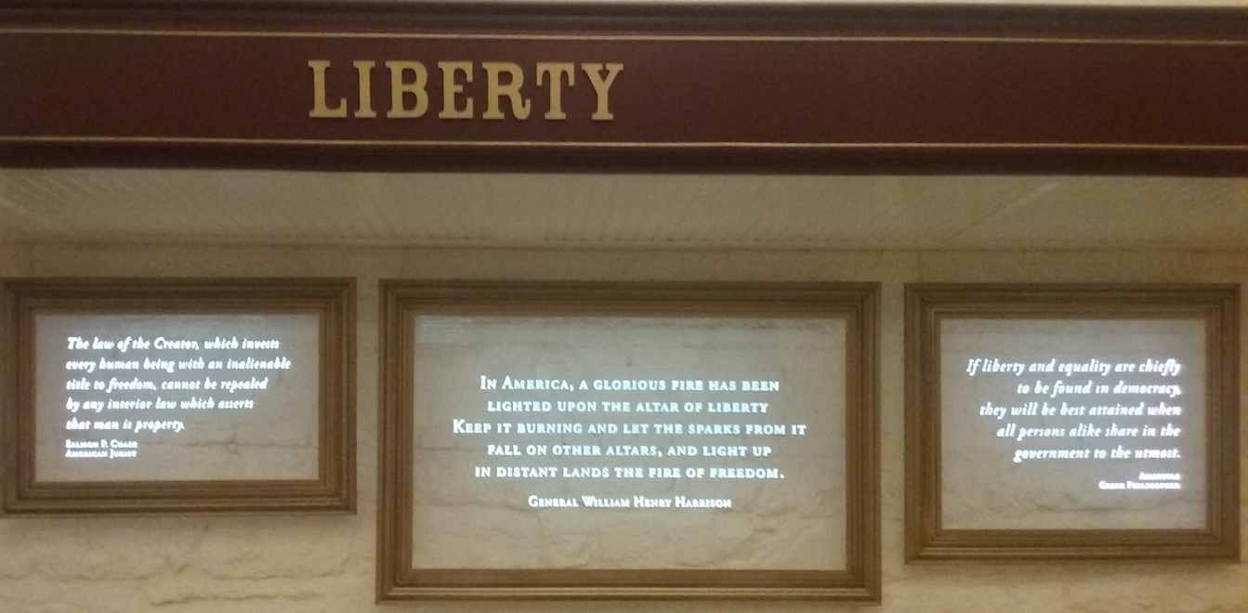
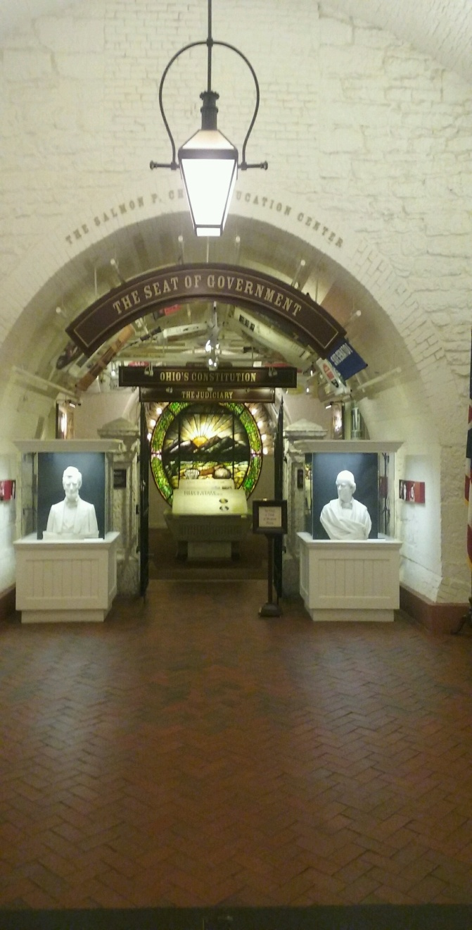

Slide 33
Statehouse doors recessed
Statehouse elevator
Stage Coach

Slide 34
Rotunda & Seal
Richland Commissioner Marilyn John & Belinda Fulton

Slide 35
Perry's Victory depicts a key battle of the War of 1812, The Battle of Lake Erie, in which Oliver Hazard Perry led the American forces to victory over the British. Perry's flagship, the Lawrence, had caught fire and his crew suffered heavy casualties. The survivors, including Perry, rowed to another American ship, the Niagara, and continued the battle, outmaneuvering the British.
Perry is the original speaker of the famous quote "We have met the enemy and they are ours." His battle cry at Lake Erie was "Don't give up the ship." Perry is also known for overcoming near-death experiences in battle and from illness, attributed to "Perry's Luck." The victory at the Battle of Lake Erie is attributed to this mysterious good fortune.
Ohio artist William Powell created the painting Perry's Victory as the first piece of artwork commissioned by the State of Ohio. But after completing it, Powell asked for three times the agreed-upon price, refusing to give up the painting. Instead, he exhibited the painting around the nation and received another commission for a similar piece which now hangs in the U.S. Capitol in Washington, D.C. Finally, the State of Ohio met Perry's higher price, and the painting hangs in the Rotunda at the Ohio Statehouse.

Slide 36
Nancy Putnam Hollister was the first, and to date only, female Governor, serving briefly from December 1998 to January 1999. She only served 11 days in office, making her Ohio's shortest-serving Governor, as she was finishing out Voinovich's term
Linda Reigle
Tour Guide Ms. Trump
Maria Newlove

Slide 37
Senate Floor.
You can only walk on the floor if invited by Senate same with House Floor.
Senate Ceiling.
Replica oil lamps

Slide 38
Franklin County Commissioners
Marilyn Brown
Paula Brooks
John O'Grady
Franklin County Engineer
Franklin County's government structure includes 33 agencies, 42 independently elected officials, and 39 appointed boards, commissions and committees.
Established: April 30, 1803
2010 Population: 1,163,414
Named for: Benjamin Franklin, American Statesman, Scientist and Inventor
Dean C. Ringle - P.E., P.S.

Slide 39
47 in attendance
representing 25 counties;
Allen, Ashland, Ashtabula, Butler, Carroll, Clark, Erie, Gallia, Guernsey, Hancock, Highland, Huron, Licking, Lorain, Medina, Morrow, Ottawa, Pickaway, Richland, Ross, Summit, Tuscarawas, Union, Williams & Wood
18 from engineers
29 from commissioners office

Slide 40
CCC / EAPA
Thanks The Staff of
CCAO and CEAO
for your assistance and advice. These regional networking opportunities are made possible with you!

Slide 41
Brad Cole, Managing Director, Research
Brain Mead
Policy Analyst
Suzanne Dulaney, Esq
Executive Director
John Leutz, Esq.
Legislative Counsel
Cheryl Subler
Managing Director, Policy
Tanya McComas
Administrative Assistant
Andrew P. Johnson
Communications Coordinator
Mary Jane Neiman
Public Relations Associate
Amanda Jones
Program Assistant
Kathy Dillon,
Office Manager and
Boards' Liaison
CCAO STAFF

Slide 42
The County Commissioners' Association of Ohio (CCAO) works to bring the most innovative ideas and efficiencies to local government.
By providing county commissioners and their staff with the necessary tools, they can achieve greater economic recovery for each of Ohio's 88 counties.
They must work together on an environment of economic development and job creation so that Ohio is the best place in the country to live, work, play, and raise a family.
CCAO will also continue to provide legislative representation, technical assistance, and educational opportunities for county commissioners and their staff.
If they are to successfully promote Ohio's counties, the members must have a working knowledge of the complex issues and questions they will face.
CCAO can help commissioners prepare for the many different issues that they may encounter.
CCAO represents 88 counties working together for a common goal of cost efficient, quality governance; and are always open to embracing new means and methods for reaching that goal.

Slide 43
Fredrick B. Pausch Executive Director
Jennifer Shuey
Director of Operations and Education
Allison Sweeney
Membership and Program Assistant

Slide 44
About the CEAO
The County Engineers Association of Ohio (CEAO) raises the technical and non-technical standards of service rendered to the general public by the County Engineer and his or her employees by establishing a central point for reference and group discussion of mutual problems.
The CEAO provides conferences, seminars, and workshops to its members on selected subjects relating to engineering concerns and local transportation systems. Special bulletins about critical state and national legislative matters are frequently issued.
Each of Ohio's 88 counties elects a County Engineer. Only persons who hold registration certificates form the State of Ohio as both Registered Professional Engineer (P.E.) and Registered Professional Surveyor (P.S.) may hold the office of County Engineer. To achieve both accreditations requires a minimum of a college degree in engineering and surveying, four years of experience in engineering and surveying, and 16 hours of testing for each license. Ohio has the most rigorous standards in the United States for qualifying its County Engineers.
"ALL TRAVEL STARTS AND ENDS ON A LOCAL ROAD"
Since 1940, the County Engineers Association of Ohio has worked to unify its members in providing the highest quality transportation, drainage, surveying and land record keeping services. From the safe and efficient movement of people, goods and services to continuing land development needs, CEAO strives to construct solutions for many challenges to Ohio's local infrastructure.
And, job number one is the traveling safety of our constituents and the visiting, traveling public.

Slide 45
2014 Winter Conference - OH - IO
Betty
Theresa
Nancy
Pam & Bev
Jesicca
Stacy
Sandy & Ronda
Commissioner Kokoski, Lorain
Cheryl

Slide 46
Various regional meetings
Throughout the years

Slide 47
CCC/EAPA
Swearing In
2012

Slide 48
CCC/EAPA
Various conferences

