Slide 1
2015 Winter Conference County Commissioners Clerks/ Engineers Administrators Professional Association Road Rights
Easements, Establishments,
Abandonments and Vacations

Slide 2
Easement
A highway easement conveys, in perpetuity, the right to construct and maintain a highway facility on the land of the fee holder. (Property owner)
The owner retains the underlying fee. (Still owns the land)

Slide 3
Establishments
To found, institute, build or bring into existence.
The board may take action to Establish a road following the process in ORC 5553 for the following reasons:
Freeholder road petition
Petitioned by 51% of those being assessed
Act on its own initiative

Slide 4
County Commissioners
ORC 5553.02
The board may locate, establish, alter, widen, straighten, vacate or change the direction of any roads in the county except state highways, for which approval by the State Director of Transportation is required.

Slide 5
Abandonments
To give up with the intent of never again claiming a right or interest in.
Loss of the right in and to any public road, highway, street, or alley which has been abandoned and not used for a period of twenty-one years

Slide 6
Vacation

Slide 7
Vacation
The act of leaving something one previously occupied
Removing a road/street/alley from the county or township road system and returning it to the adjacent property owners

Slide 8
Highway Easements

Slide 9
Existing Right –of - Way
Limited Access Roads (interstate, bypass, connector, etc) have varying width and are usually taken by deed and the property is owned by the state and/or county
Collectors 70-80 feet
State Roads 60 feet
Rural County Roads 50 feet (25 each side)
Township roads 40 feet

Slide 10
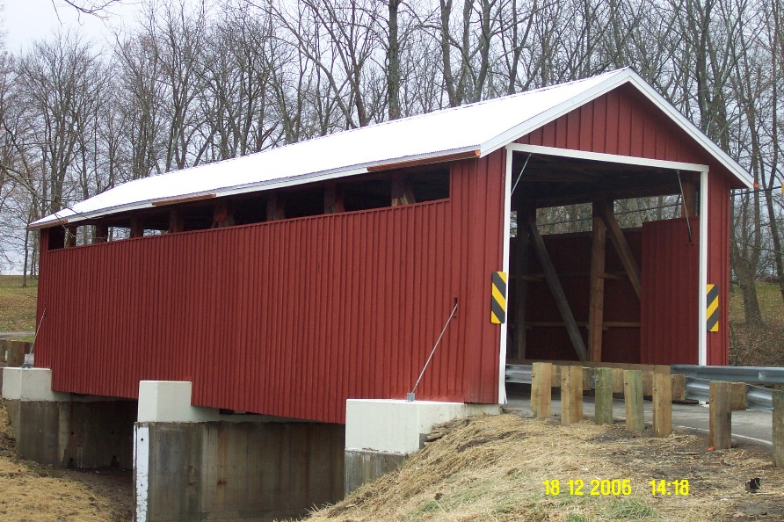
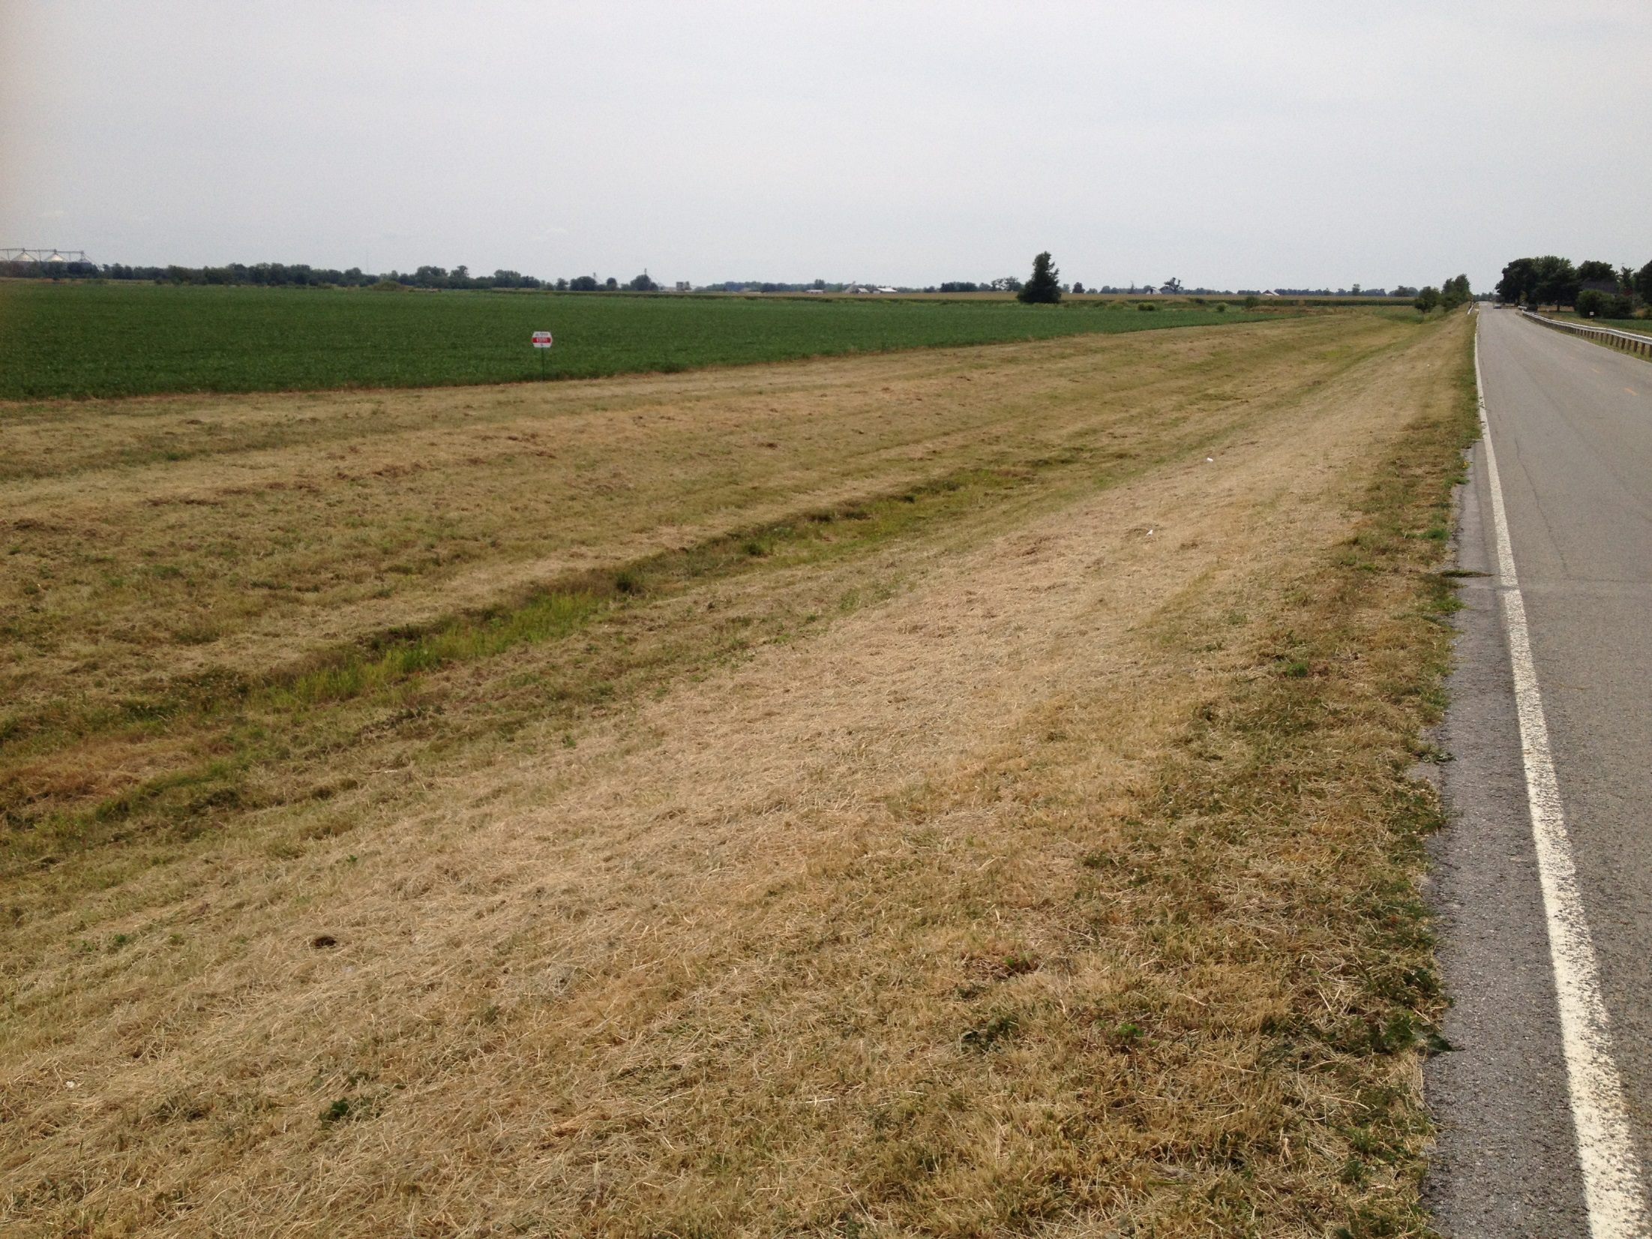
Why do we need an Easement?
Bridge Projects
Road Re-alignment
Safety Improvement
Widening
Drainage Improvements
Guardrail projects
Culvert Extensions
Ditch Widening

Slide 11
Standard ODOT Easements
Highway Easements: Where there is a right to construct and maintain a highway facility
SH - Standard Highway easement
LA - Limited Access Easement

Slide 12
Non-Highway easements: convey rights associated with the highway facility.
T Temporary
SL Slope Easement
S Sewer Easement
CH Channel Easement
FL Flowage Easement
U Railroad or Public Utility
A Aerial Easement
PRE Property Right
SC Scenic

Slide 13
Clinton County Example
How do you find if there are existing road easements?
Which type of road easements should we be keeping track of?
How do we show or track these easements in the future?

Slide 14
Spring Hill Road

Slide 19
Standard Highway Easement
The grantor….for consideration paid by the the grantee, do hereby grant, bargain, sell, convey and release to said Grantee, its successors and assigns forever, a perpetual easement and right-of-way for public highway and road purposes, in, upon and over the lands hereinafter described….

Slide 20
Easement Rights
Is an easement still legal if it is not recorded?
YES
Can you record an old easement?
YES
What would happen if another easement got recorded before we recorded our easement?
First one recorded takes precedence
What happens if the land has transferred before you record your easement?
Your easement may be void?

Slide 21
Tax Map Records
Do you currently show any highway easements on your tax maps? Why?
How do you show where easements are on existing maps or do you have a separate layer just for easements?
How do we make sure that we pick up easements in the future?

Slide 22
Warranty Deeds
What is the difference between a warranty deed and an easement?
Why would you use one over the other
When are they required
Who has the authority to acquire
Who’s name is it in?
How do you pay for easement or deed.

Slide 23
Warranty Deed at Bridge

Slide 24
Bridge Project with Warranty Deeds

Slide 25
Warranty Deed with Temporary Easements

Slide 27
Requirements for Surveys that are filed in the Map Office
Can you require highway easements to be shown on a new survey to be filed in your office?
Do they need to show reference to where it is dedicated?
How do you carry acreage?
Do you provide easement acreage to your Auditor for taxing purpose?

Slide 28
OAC Requirements
4733-37-05 Plat of survey.
(A) The surveyor shall prepare a scale drawing of every individual survey, or drawings comprising all of the surveys when they are contiguous, in which the surveyor retraces previously established property lines or establishes new boundaries.
(B) A copy of this drawing shall be given to the client. When required, another copy shall be filed with the appropriate public agencies.
(C) The surveyor shall include the following details:
(1) A title such that the general location of the survey can be identified. The title shall include, but not be limited to: state, county, civil township or municipality, and original land subdivision description.
(2) A north arrow with a clear statement as to the basis of the reference direction used.
(3) The control station(s) or line cited in the description and the relationship of the property to this control must be referenced to an established monumented point of beginning such as, but not limited to: centerline intersection of streets or highways record, section or quarter section corners, Virginia military survey corners or lines, or platted lot corners. The type of monuments set or found at the control stations shall be noted.
(4) A notation at each corner of the property stating that the boundary monument specified in the deed description was found, or that a boundary monument was set, or a legend of the symbols used to identify monumentation. In addition, there shall be a statement describing the material and size of every monument found or set.
(5) A general notation describing the evidence of occupation that may be found along every boundary line or occupation line.
(6) The length and direction of each line as specified in the description of the property or as determined in the actual survey if this differs from what is stated in the deed description by more than the tolerance specified in paragraph (B) of rule 4733-37-04 of the Administrative Code. The length and direction shall be stated as follows:
(a) Bearings expressed in degrees, minutes and seconds and distances expressed in feet and decimal parts thereof on each course. If a metric equivalent distance is stated, it shall be stated to the third decimal place.
(b) All curved lines shall indicate the radius, central angle, curve length, chord bearing and chord distance.
(c) Each course shall show other common lines such as centerline of roads, rivers, streams, section lines, quarter section lines, half section lines or other pertinent common lines of record.
(7) A citation of pertinent documents and sources of data used as a basis for carrying out the work. The citation shall include, but not be limited to: current deeds as of the date of the survey, prior deeds or other documents of record, and available deeds of record for adjoining parcels along each boundary line of the survey. If the adjoining parcel is a recorded subdivision, only the subdivision name, recording information and lot numbers need to be shown.
(8) The written and graphical scale of the drawing.
(9) The date of the survey.
(10) The surveyor's printed name and Ohio registration number, signature and seal (in a form which may clearly reproduce on any copies which may be made of the original drawing).
(11) The area contained within the perimeter of the surveyed parcel.
(12) All references to roads or railroads contiguous to the surveyed parcel shall use current names or names of record and applicable right of way widths, if available.
(13) All references to rivers or streams shall use current names of record, if available.
R.C. 119.032 review dates: 05/09/2014 and 05/09/2019

Slide 29
Sample plat of survey

Slide 30
ALTA Survey Requirements American Land Title Association
Evidence of any easements or servitudes burdening the surveyed property, disclosed in the Record Documents provided to the surveyor and observed in the process of conducting the survey
Evidence of any easements or servitudes not disclosed in the Record Documents but observed in the process of conducting the survey: R/W roads, Utilities on or across the property if they affect the property

Slide 31
ALTA Survey Requirements
Surface indications of underground easements or servitudes on or across the surveyed property observed in the process of conducting the survey
Evidence of use of the surveyed property by other than the apparent occupants observed in the process of conducting the survey.
Counties do not require ALTA surveys to file a survey in the map office

Slide 32
Tax Map: Where is the easement ?

Slide 34
Resulting Issues...
The problem with this easement was that it went to court and there was a judgement entry, but it was never recorded.
Auditor will still carry the total acreage, but now has idea of easement area for appraisal purposes.
This is why we need to keep track of easements

Slide 35
County Guidelines
We require that any new survey of property that has “roadway easements” be shown on the survey.
They are required to reference the plat where it was dedicated or provide Book and Page where it is recorded.
We will set up separate layer in our GIS to track highway easements.
We will never be able to capture all easements with our mapping.

Slide 36
Vacating Roads and Alleys

Slide 37
Ohio Revised Code 5553.02
The board of county commissioners may locate, establish, alter, widen, straighten, vacate, or change the direction of roads as provided in sections 5553.03 to 5553.16 of the Revised Code.

Slide 38
Ways to Vacate Roads and Alleys
Petition by Landowners
Petition by Township Trustees
Petition by the Director of Transportation
Township losing rights to abandoned, unused road.

Slide 39
Sample Petition and Survey
Petition by Owner(s)
Plat Submitted

Slide 40
Description and Notice
Description
Notice to Commissioners

Slide 41
Petition by Township Trustees (5553.045)
A board of township trustees may petition the board of county commissioners to vacate a township road or a portion of a township road by passing a resolution that requests the vacation of the road or portion and includes a description of the general route and termini of the road or portion.

Slide 42
Example of Township Request

Slide 43
Village Vacation of Cul-de-sac

Slide 44
Commissioner Process Township Petition
Set a date for a public hearing on the vacation of the road or portion that is not more than forty-five days after the date that the resolution is filed with the board.
Fix a date when it will view the proposed vacation.
Clerk to notify by regular mail the landowners abutting the road proposed to be vacated at least 20 days before the boards public hearing

Slide 45
Process continued
Give notice of the time and place for both such viewing and hearing by publication once a week for two consecutive weeks in a newspaper of general circulation in the county where such improvement is located.
Notice shall briefly state the character of such improvement/vacation

Slide 46
Hearing
After the public hearing, if the board determines that the vacation of the road or portion of the road would be for the public convenience or welfare, it shall adopt a resolution by majority vote declaring road or portion to be vacated and file a certified copy of the resolution with the petitioner , the county recorder and the county engineer.
If Board take no action within sixty days after township resolution in filed, the road shall be deemed vacated

Slide 47
What Happens Next…
Once the certified copies of the resolution declaring a road or portion of a road vacated are filed, the board of township trustees, by resolution, shall order the road or portion of the road vacated. The vacated road or portion of the road shall pass, in fee, to the abutting landowners subject to all of the following:
(1) A permanent easement as provided in section 5553.043 of the Revised Code in, over, or under the road for the service facilities, as defined in section 5553.042 of the Revised Code, of a public utility or electric cooperative as defined in section 4928.01 of the Revised Code;
(2) The right of ingress or egress to service and maintain those service facilities;
(3) The right to trim or remove any trees, shrubs, brush, or other obstacles growing in or encroaching onto the permanent easement that may affect the operation, use, or access to those service facilities.

Slide 48
Clinton County Viewing
Usually the coldest day of the year.
All three commissioners and Clerk attend the viewing.
County Engineer attends.
Map Office attends if necessary
Have maps available of proposed vacation
Adjacent property owners usually are there
Questions are answered.
Be careful where you step.

Slide 49
Clinton County Hearing
Usually Hearing immediately follows Viewing and is held back at the Commissioners office.
County Engineer attends
Map Office may attend
Prosecutor only attends if requested
Property owners rarely attend
Once Hearing is closed, the commissioners act the same day

Slide 50
FAQ’s
Can the engineer/ map office require a map and legal description?
May the commissioners ask the engineer/map office to write a description?
What research does the map office do?
Does map office attend site visit/ hearing?
What research does the auditor do?
Should auditor also attend site visit?
Who provides adjacent landowners addresses -auditor or map office? mailing or tax bill address?
What happens when research shows encroachments, buildings, etc. on the alley?

Slide 51
Issues
How should vacated Alley/Road be split?
How do you show it on your parcel map?
How do you tie it to the Commissioners records?
How does the auditor tax it?
How do you make sure it shows up in the Auditors database?

Slide 52
Supreme Court Case 75-635
Upon vacation of an alley by a city, abutting lot owners, as to that portion of the alley abutting their properties, are vested with a fee simple interest in one-half of the width of the strip of land which formerly comprised the alley, irrespective of the fact that the original owner and dedicator of the land was not the predecessor in title to all such abutting lot owners; subject, however, to those rights which other owners may have in the alley as a necessary means of access to their properties.

Slide 53
How is the alley/road split?
When a public alley is vacated, the fee vests in the abutting owners
ORC 5553.045: Title to pass to the abutting landowners
Our County Prosecutor has given us the opinion based on the Supreme Court case that we use the same process for vacations outside the municipal corporation as well.

Slide 54
Existing Parcel Includes Parts of Lots and Parts of Alleys

Slide 55
GIS Vacation Layer

Slide 56
Detail of Vacated Alleys/Roads

Slide 57
Vacation Layer
Our vacation layer has the following attributes:
Resolution Number
ID Number
Municipality
Hot link to PDF file containing all documents

Slide 58
Auditor Records
The existing parcel is given a new designation of VA on the end of the parcel number
Auditors office knows not to transfer unless the parcel has been re-surveyed

Slide 59
Contact
Jeff Linkous
Clinton County Engineer
937-382-2078
jlinkous@clintoncountyengineer.org
Brenda Godlove
bgodlove@clintoncountyengineer.org

